Slide 1
Lake Powell Pipeline and Local Water Management
Kayenta Desert Arboretum Lecture Series
Tom Butine - March 30, 2021
Notes:
Presentation intro
Thank you for your interest in our water and joining this discussion.
I’m Tom Butine, and I’m the board president of Conserve Southwest Utah.
My education and career has been mostly STEM with management and finance mixed, all in aerospace, not remotely related to environmental work.
Conservation and interest in the environment come by avocation and personal experience since I was a little kid.
I stumbled into this volunteer job as board president of Conserve Southwest Utah by happenstance.
I’ve learned about conservation in Utah informally, using my background in research and analysis.
I haven’t given a presentation on water in a couple years, and found I had to make a new one for you. Hopefully I can use it more than once.
You’re about to learn that I’m not a communications professional, but I’ll do my best to present a rather complicated story in an understandable way.

Slide 2
Founded 2006 by regular citizens – now >2,000 locals
Catalyst - Federal bill: land transfer, LPP, Northern Corridor
No lobbyists or lawyers, but great coalition partners
One full-time staff (Sarah, on public lands), otherwise all volunteers
We research, find alternatives, communicate, advocate, act
Programs: Public Lands, Water, Climate/Air Quality, Smart Growth
Notes:
So we’ve been analyzing the LPP for 15 years.

Slide 3
Let’s do a little informal before and after poll
How many were here when Zach presented a couple weeks ago?
How many of you are
Leaning toward thinking the LPP makes sense?
Leaning in the opposite direction?
In the middle?

Slide 4
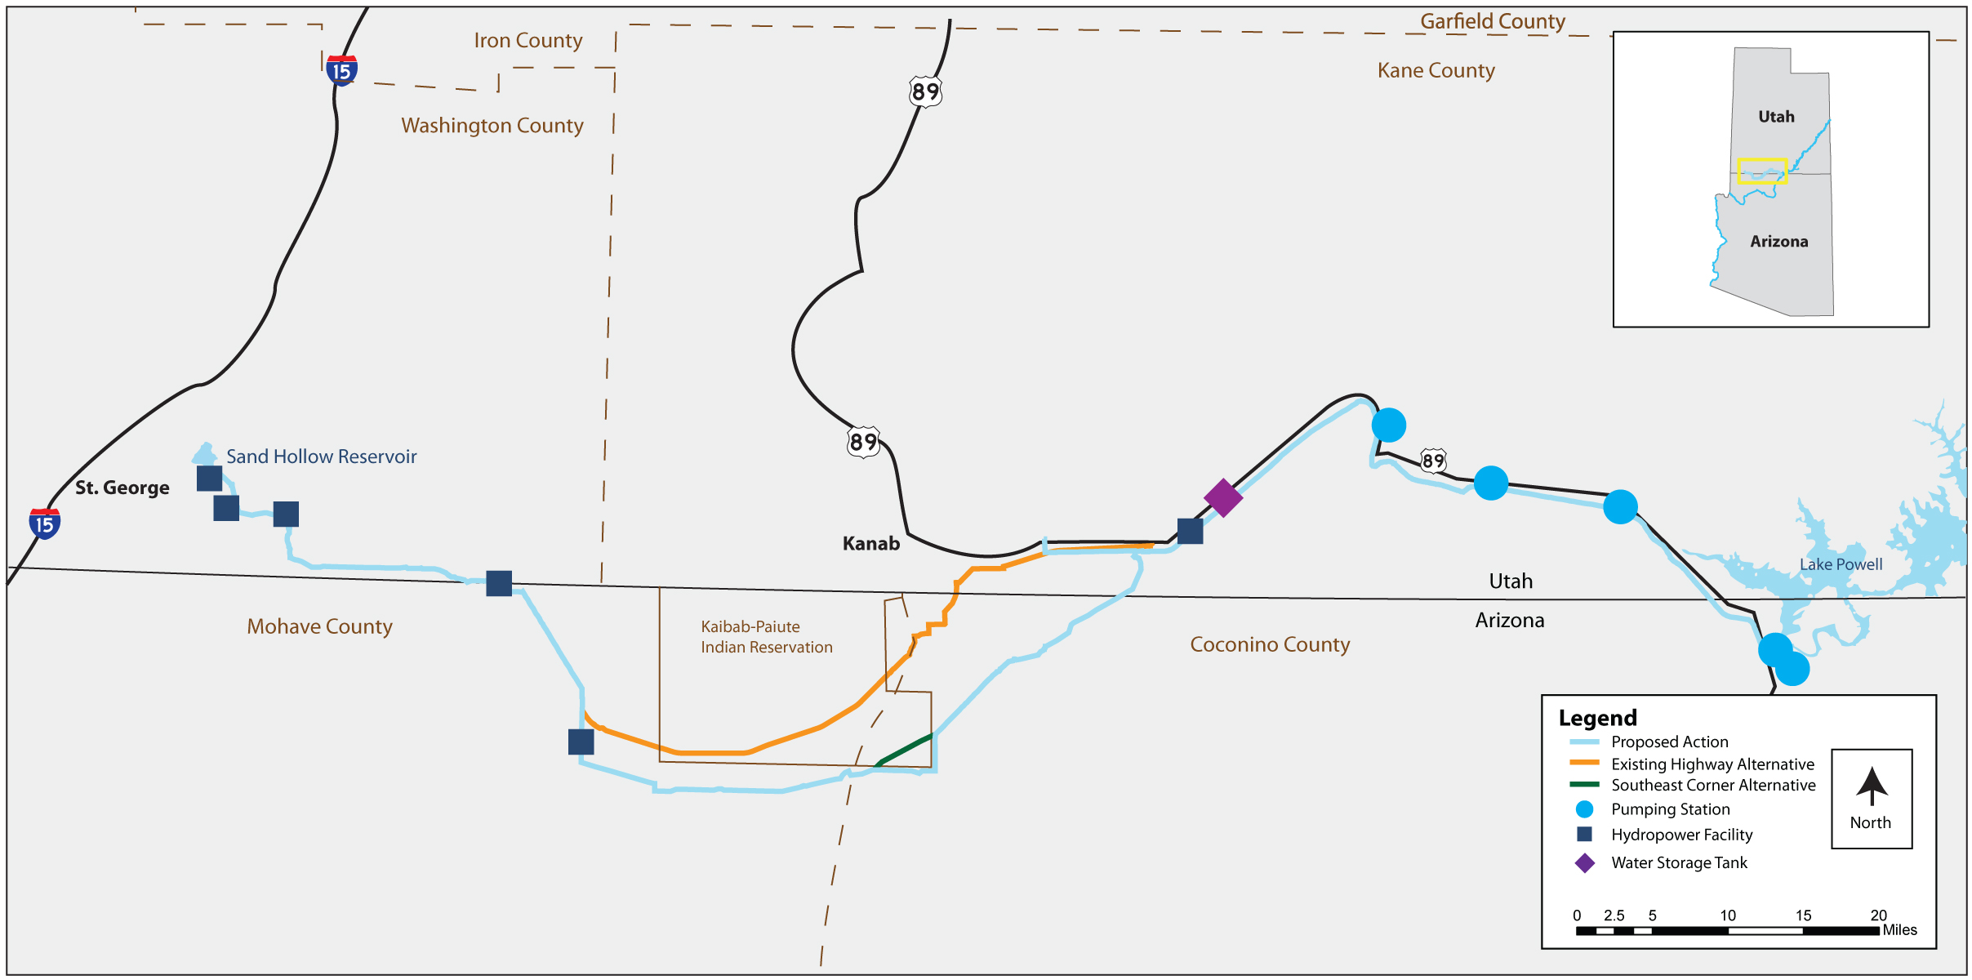
The LPP
~ 140 miles
~ gains 2,500’ elevation
~ 6’ diameter
~ 82,000+ acre-feet/year (AFY) (28B gal)/yr)
~ $1.5-2 B (x2 with interest over 50-60 yrs)
~ 2030 target completion
Preferred route, to avoid Paiute Tribal lands
Notes:
I’ll explain why the LPP is unrealistic,
and how we must go forward.

Slide 5
Classes of Water¹
Municipal (M&I)
20% (~35% in Washington County)
Residential (75%) and CII (commercial, institutional, and industrial)
Indoor and outdoor - 80% outdoor (mostly grass)
Culinary (85%) and secondary/untreated (15%)
Municipal water districts (e.g., WCWCD)
LPP: M&I
Agricultural (Ag)
80% (~65% Washington County)
Most senior water rights
Secondary water - can convert to M&I
Supplied by “irrigation districts”
Diversion
Depletion
Loss
Re-use
Notes:
There are some footnotes in this presentation so you can see our sources. The handout has a link to the presentation so you can chase them if you wish.
When water usage is discussed or compared, the class of water being considered: is important
Is secondary water included?
Is re-use included?
Is it only Residential?
It’s very easy to misinterpret the data if it isn’t qualified.
Footnote:
1 https://dwre-utahdnr.opendata.arcgis.com/datasets/mnireport2019-counties

Slide 6
CSU’s Position
In a nutshell:
The LPP is not needed (but it’s definitely wanted by some)
Even if we want it badly, it’s not affordable
Even if we decide it’s affordable, it’s too damaging
Even if we accept the damages,
There is no water for it.
Notes:
1. Need verses Want
Yes, a viable 2nd source would be nice, even though very few desert communities have one, but it is not viable.
LPP proponents worry about the impact of not building the LPP: hamper growth, no green.
That worry can be debunked by comparisons with other areas in the southwest
Ours worry is the opposite—the cost burden, the change to the demographics due to it, the environmental damage, the impacts on tribes and the rest of Utah.
And the fact that the risk is so high that it is not feasible
Let’s get into each of the 4 points, concentrating on the last one.

Slide 7
1. LPP: not needed
Washington County M&I water use¹
2000: 330 gpcd?
2018: 303
2019: 271²
County goal: 240³ (2040 to 2075)
Other Southwest Cities: 160, now
Year | Projected Population | Water Use Supported by Local Water Supply (100,000 acre-feet yearly)⁴
2040 | 321,000 | 285 gpcd
2050 | 391,000 | 234
2060 | 469,000 | 194
A personal anecdote
Notes:
Footnotes
Measured in GPCD – gallons per capita daily.
Data prior to 2016 was highly inaccurate and was declared unusable by the legislative auditor (https://water.utah.gov/legislative-audit-process-reports/); it was very unclear what classes of water was included and how it was measured.
Data since 2016 is reported by the county to Utah’s Open Water Data: https://dwre-utahdnr.opendata.arcgis.com/datasets/mnireport2019-counties. 2020 data is not yet there.
We suspect 2019 improvement was due to bigger new homes on smaller lots with less landscaping, plus some better public awareness. No active conservation measures such as landscaping ordinances, rate structures, property tax subsidy removal.
Per the 2020 LPP Draft Environmental Impact Statement. This is a ridiculously high goal.
Projected local water supply, per the Washington County Water Conservancy District (WCWCD) is 100,000 AFY (AFY= 1,000 acre-feet yearly; about 326,000 gallons per AF; 100,000 AFY = 32.6 B gallons. Past projections have stated 140,000 AFY. Factors and derivation of this projection have not been subjected to public review.
Talking points:
Other SW cities: like Las Vegas, Tucson, Denver, even Los Angeles.
We should be able to easily make future demand goals.

Slide 8
2. LPP: not affordable
$1.5-2B construction
+$2B interest and contingencies = $4B+
$10,000 impact fee increase
$1200+/yr rate/tax increase¹
Biggest capital project ever in Utah
Can Washington County REALLY afford it?
LPP Costs
(must be paid)
Increased Water Price
Decreased Water Use
Utah’s choices: LPP …OR education…OR health care …OR transportation…OR justice system…OR…
Notes:
Footnotes
Calculating the cost per person is complicated, with lots of variables and options. See analysis: https://conserveswu.org/wp-content/uploads/2017/02/LPP-Debt-payment-calculation.pdf
Talking points:
The payback mechanisms would be a mix of property taxes, fees on water use, connections for new homes and businesses, and visitors.
How will it change water use behavior?
What will it do to the demographics?
Will we become another Park City or Jackson Hole, a place for vacation homes, resorts, tourists, with a “service” population living at the fringe?
The costs would push water demand down, but that would cause the price of water to rise because the LPP costs still have to be covered.
The economics law of “price elasticity” says that demand decreases as price increases. We’ve all experienced it personally.
The reality of the finances will at some point become clear.
State budget is only about $20B
No clear understanding on the impact to household budgets.
Lots of variables

Slide 9
3. LPP: too damaging
Permanent scar: 140 mile - 200’ wide swath
Damage to habitat, streams, cultural artifacts
Tribes opposed – damage, no benefits
Climate impacts for pumping 2,500 feet elevation

Slide 10
4. LPP : no water for it
Can’t be argued that it’s needed….only wanted
“Not affordable” and “too damaging”: judgment and values
“No water”: facts
Two parts:
Allocation of water to Utah (the Colorado River Compact)
Allocation of water within Utah (“Prior Appropriation”)

Slide 11
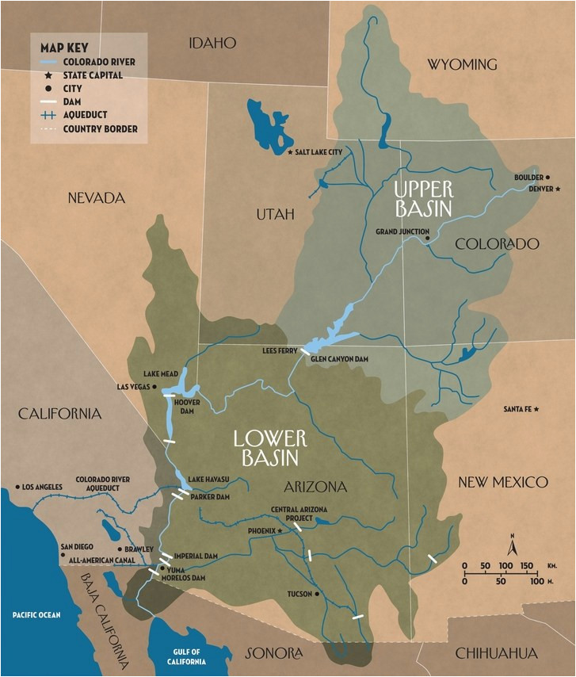
4. “No Water”
Part 1: Allocation to Utah
-The Compact-
The Upper Basin must release 7.5 MAFY
Leftover split between the 4 Upper Basin states – 23% to Utah
An often misrepresented point
Utah not entitled to FIXED amount
Notes:
Trace the river and the features
UB has used a constant 4 MAFY for the past 40 years, even with the huge growth
LB has used 8-10, but has recently seen the future, and cut way back, even with their huge growth

Slide 12
4. “No Water” Part 1: Allocation to Utah
The Compact’s Current Operation versus The Reality
Science
Values
Negotiation
Bottom Line
Notes:
The Compact sets up a competition between states: over-allocate, and see who can grow the fastest and claim the most water.
Footnotes
The Compact Commissioners ignored scientific inputs at the time that suggested historical flows were well below 18 MAFY, closer to 14. Scientific studies based on over 600 years of tree-ring data (“Colorado River Flow at Lees Ferry, CO”, Stockton and Jacoby, 1997, TreeFlow, htpps://www.treflow.info/context/upper-colorado; see Fig 5, Science Be Dammed, Kuhn and Fleck, 2019, pg. 185) indicate 13.5, with high standard deviation and frequent mega-droughts.
Climate change’s impact on river flows is uncertain, but studies indicate ~10% decrease per ºC average temperature increase. This could result in a 19-31% decrease by 2050. See “Colorado River Flow Dwindles as Warming-Driven Loss of Reflective Snow Energizes Evaporation”, Mille and Dunne, Science, Feb 2020; Haste of Global Warming Trend Opposed, Philip Shabecoff, 1983, New York Times; Science Be Dammed, Kuhn and Fleck, 2019, pg. 189. Historically under-estimated impacts indicate we should err on the conservative side: 30%.
Includes evaporation from the reservoirs and the river itself. Estimates for losses in Lakes Mead and Powell are in the range of .5 - .7 MAFY (https://www.colorado.edu/today/2015/12/28/reservoir-evaporation-big-challenge-water-managers-west, https://bouldercityreview.com/news/researchers-study-true-scale-of-evaporation-at-lakes-mead-powell-51822/, https://www.cpr.org/2019/04/07/researchers-study-reservoir-evaporation-for-better-budgeting-of-colorado-river-water/, http://www.swhydro.arizona.edu/archive/V4_N2/feature4.pdf) ; the many other smaller reservoirs could lose half that much cumulatively.
Humans have taken as much water from the ecosystem as they can, as evidenced by dry river delta at the Gulf of California. Restoring it could take as little as 0.1 MAFY (see “Where the Water Goes” by Owen, page 225), but there is no plan to do so.
Per the 1944 treaty, Mexico’s allocation is 1.5 MAFY. Per a 1963 agreement, Lower Basin tribal allocation is 0.9 MAFY. Upper Basin tribal allocations are in dispute but are 2-5 MAFY. Illogically, the Compact has left it up to the states to address tribal rights within each state. Utah has repeatedly failed to adjudicate tribal rights within the state. The assumption here is that it could be negotiated to 3 MAFY, but nothing is clear (https://www.watereducation.org/aquapedia/mexico-and-colorado-river-water, https://waterkeeper.org/news/native-american-water-rights/). Tribes don’t have the financing to build a pipeline like the LPP to access their water.
It was originally thought that splitting 15 MAFY between the 2 basins (7.5 each), leaving 3-5 for Mexico and the Tribes, would be sustainable. That has not been proven incorrect.
The Lower Basin is allocated a fixed 75 MAFY/10 yrs (7.5 MAFY/yr average). It clearly is not sustainable.
By negotiation, the Upper Basin does not have a fixed share: it gets whatever is left over after the LB gets their allocation. Its estimate was reduced to 6 MAFY in the 1960s by agreement as it became apparent the river flows were lower than expected, but, again, that is not guaranteed. Considering the new reality of the river’s flow, the LB will not be able to get their 7.5 MAFY allocation and the UB would get none. This is not a practical situation. A 50:50 split is assumed here, but may be over-optimistic for the Upper Basin considering the Lower Basin uses more now, would have more impact under reductions, and has more political power. Utah’s new Colorado River Authority will be challenged in protecting as much current use as possible, much less adding the LPP. The stated purpose of the Authority seems unrealistic (see the “Utah” paragraph in https://www.hppr.org/post/colorado-river-showdown-looming-let-posturing-begin)
29% of the Upper Basin’s variable/not guaranteed flow, as agreed by the Upper Basin.
As reported by the Utah DWRe.
A simple subtraction, indicating Utah must reduce its current use by 25% (which is 3x the LPP’s capacity), never mind adding the LPP or planned uses by any other senior water rights.
The LPP could only carry water if there is a massive re-allocation within Utah of senior water rights. The is no concept, process or plan to do this.

Slide 13
February 2021 Utah Center for Colorado River Studies¹
Key Finding:
The river is sustainable, even during worst cases, but only if Upper Basin limits future water use and Lower Basin takes significant cuts.
Notes:
Footnote
1. From Utah’s own experts on the river: https://qcnr.usu.edu/coloradoriver/futures
Selected quotes:
“[T]he Colorado River water supply can be sustainably managed, even during extreme [Millennium 2000-2018] drought, if future growth in Upper Basin water use is limited, and significantly larger shortages are applied to the Lower Basin States and Mexico than what are currently specified.”
“The combined end-of-year storage of Lake Mead and Lake Powell can be maintained at current levels if hydrologic conditions similar to the Stress Test period (1988-2018) occur into the future and if Upper Basin consumptive uses do not increase.” “However, if Upper Basin consumptive uses increase according to the 2007 Upper Colorado River Commission future depletion schedule, then the Stress Test conditions will result in a continuous decline of reservoir storage.”
Our elected officials and water agencies do not want to address these facts and the data behind them.

Slide 14
4. “No Water” Part 2: Allocation within Utah
Utah’s “paper” allocation NOT 1.38 MAFY…only 23% of the leftovers
Utah has issued 33,000 Colorado River water rights, for 2.3 MAFY
The LPP water right is # 23,590, very junior
with 2 MAFY of senior water rights ahead of it
Even the “paper” water right is not secure.
Notes:
Utah’s system of water rights was established in an era of subsistence agriculture, using the concept of “Prior Appropriate”, just like most of the West (different from the East): “first in time, first in right”.
This doesn’t support municipal growth or wise water use.
There is no concept or mechanism or plan for a mass re-allocation of water rights.
Even if the basic state of the Colorado River was not an issue, the LPP would have to overcome senior Ag water rights

Slide 15
CSU’s Position
In a nutshell:
The LPP is not needed (but it’s definitely wanted by some)
Even if we want it badly, it’s not affordable
Even if we decide it’s affordable, it’s too damaging
Even if we accept the damages, there’s no water for it!

Slide 16
The Conclusion…
All compact states (including Utah) must reduce current uses
No new projects
LPP not feasible
Don’t have to stop growth or sacrifice vibrant community
Must change how we grow
including how we manage our local water

Slide 17
Local Water Management
Industry-standard Program Management – It works!
Engage all stakeholder groups – not inside job
Define goal: “manage demand safely within projected supply”
Determine realistic supply – e.g., 100,000 AFY in 2040
Realistic demand targets – e.g., 200 gpcd in 2040
Select “best practices” to achieve demand
Like rate structure, no property tax subsidy, landscaping ordinances
Transparent
Verify results
Notes:
It is the proven and accepted way to set appropriate goals and to define strategies, tactics and plans to ensure they are achieved.
Plans will fail if all stakeholders are not engaged.

Slide 18
Current Water Management
State law requirements for Water Conservation Plan
Goals and selected conservation methods to achieve them
Implementation plan/schedule and process to measure progress
Updated every 5 years, with public engagement
Missing: no requirement to manage demand within supply
Division of Water Resources defined guidelines to meet the law
Missing: no mention goals, methods, plan…..
As a result, our “water conservation plans” are not really plans,
WCWCD’s plan update due this year
Unclear who will be invited
CSU proposed an approach in January; no response
Bottom line: our local governments and water agencies -
selling the LPP rather than managing the water we have.

Slide 19
What happens if…
Washington County realizes the LPP is not viable?
Implement Local Water Management, or
React when shortages occur
The LPP is built and the water isn’t there?
Debt, with payments to cover it
Beg for debt forgiveness (other Utahns pay for it)
Emergency demand reductions
Washington County becomes very expensive place to live
The LPP is build, and filled by taking water from other Utahns
Tribes disadvantaged, again
Take it from agricultural – politically very challenging
Washington County becomes very expensive place to live

Slide 20
The “after” poll
How many of you are
Leaning toward thinking the LPP makes sense?
Leaning in the opposite direction?
In the middle?

Slide 21
Status of Water Issues
LPP and Colorado River
EIS re-start based on public input and Compact States?
Legislature is unrealistic : HB 297 (posturing?)
2026 Colorado River Planning and Re-negotiation
Water Conservation
WCWCD plan update this year; each city updates plans
Unknown participation and approach; no plan to manage demand
The Cove Reservoir:
Diversion of upper Virgin, impacts Wild & Scenic” designation
Fuzzy logic and funding; legal challenges
Public input forced EIS, “scoping” next step
Utah is still pushing non-sensical water projects

Slide 22
Besides Water Issues…..
What else is CSU doing?
Public Lands (especially sensitive and scenic areas)
Reversing Northern Corridor decision and advancing the alternatives
Reversing Long Valley Road Extension
More permanent protections – changing attitudes and laws
Restoring damaged habitat and connecting habitat areas
Solving Climate Crisis and protecting Air Quality
Supporting global efforts, national legislation
Support local actions on reducing emissions
Promoting Smart Growth policies, which enable conservation of resources
Reducing sprawl and transportation requirements
Walkable, ridable, livable communities
Engaging whole community, including those left out

Slide 23
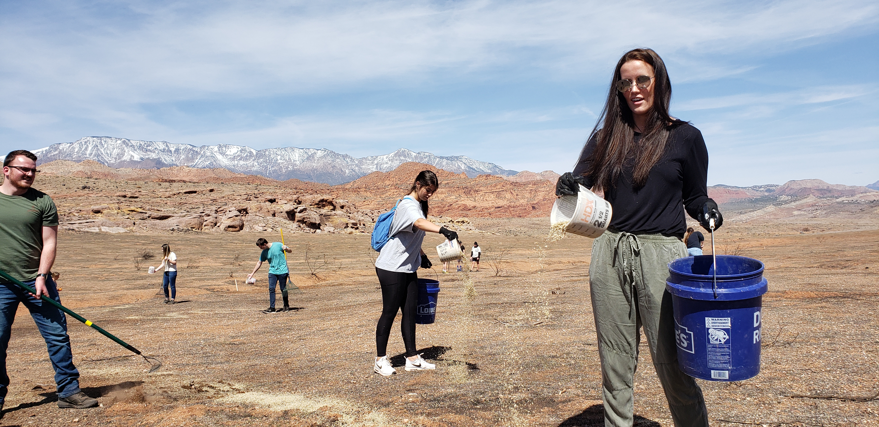
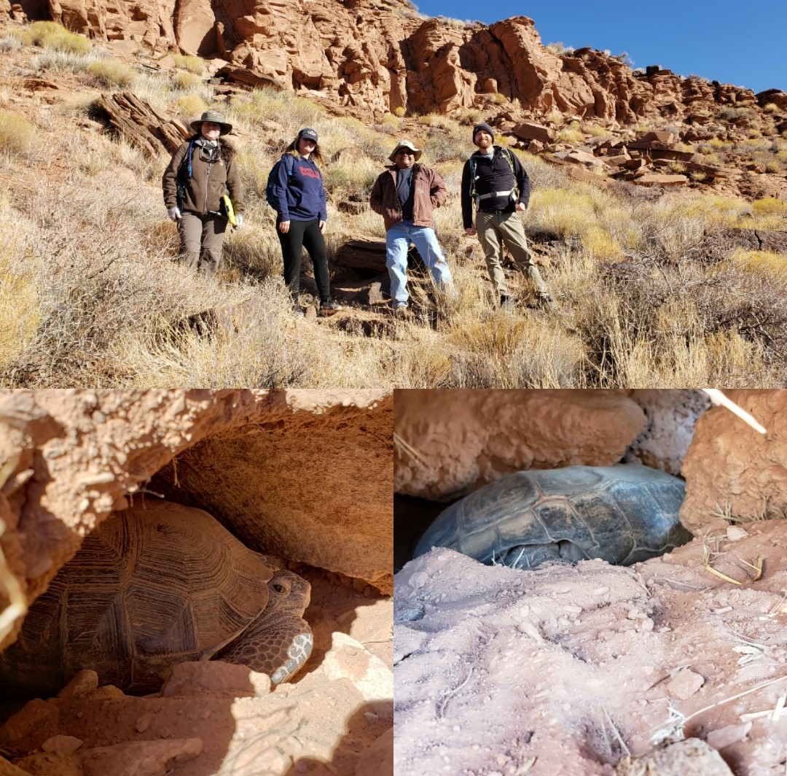
Public Lands Partnerships, Youth Outreach, Restoration
Pika’aya Tooveep
#Keep Conservation Cool
Nuestra Tierra Public Lands Internship
Habitat Restoration

Slide 24
Join us!
Conserveswu.org

