Slide 1
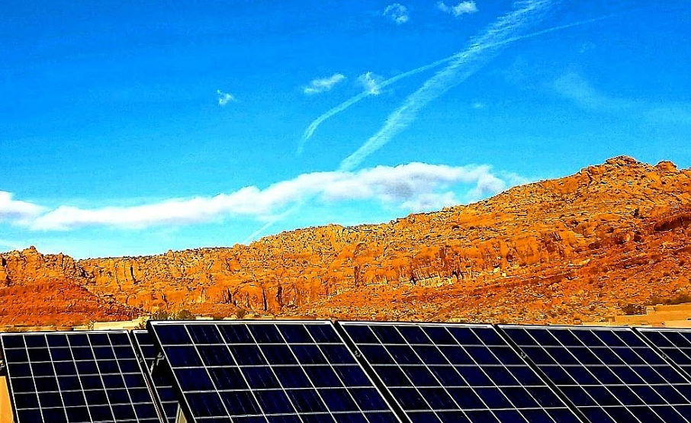





Southern Utah Clean Air Forum
Legislation for a Brighter Future
Monday, January 21, 2019 7 – 8:30 pm
Dixie State University’s Udvar-Hazy Business School Boeing Auditorium
A discussion of proposed federal, state & local legislation focused on
reducing energy emissions and improving our health and the futures of our children
For our elected representatives and their constituents

Slide 2
Introduction
Welcome
Recognition of sponsors
Purpose of the forum: inform and engage
Sign-in to keep in the loop
Notes:
We have a tight schedule, so let’s get started. Thank you for your interest and for showing up on this holiday evening, and thanks to Dr Martin Luther King for showing us how to tackle tough issues in a peaceful and respectful way.
My name is Tom Butine. I’m related to our 4 sponsors:
I’m the board president of Conserve Southwest Utah, a local grassroots organization advocating conservation of our natural resources, one of which is our air
That led me to help start a local chapter of Citizens Climate Lobby, a world-wide organization, with chapters in almost every US congressional district, which advocates legislation for clean air and clean energy. Climate Utah is focused on Utah solutions.
And I’ve been working to strengthen the relationships between Dixie State University and the community. The Udvar-Hazy Business School has a direct connection to this forum since clean air legislation has tax and business implications. Thanks to Dean Kyle Wells. The Institute of Politics and Public Affairs is also directly related since this involves legislation and has implications for the public. Thanks to Rich Cracroft.
And thanks for the interest and support from the Audubon, the League of Women Voters and the American Association of University Women.
The purpose of this forum is to inform and engage our representatives and their constituents, since these ideas won’t go anywhere without them…you.
If you sign-in, we will keep you up to date on progress and how you can help.

Slide 3
Southern Utah Clean Air Forum
State Legislation
    Why, what and how Dr. Yoram Bauman
    The process, history, action Tom Moyer
Federal legislation Bill Barron
Local resolution Sarah Thomas
Q&A, drawing Panel
Notes:
Here is our program for tonight:
Yoram and the other Tom will cover the bipartisan state legislation, the first proposal following the resolution passed by our state legislature last year to take action for clean air and clean energy.
Bill will cover the bipartisan federal legislation, introduced during the last Congress and carried forward into this year
Sarah will cover the resolution being introduced locally to figure out how the citizens of Washington County can make a difference.
Thank you Yoram, Tom and Bill for the huge effort, driving down in the snow from Salt Lake City today, and then turning around early tomorrow for an 11:00 presentation back up there.
Hold your questions until the end unless you can’t bear it. And there will be a drawing for Yoram’s books, which will are also for sale at his cost.

Slide 4

Notes:
I was working on this forum over Christmas, and one of my clearest memories of Christmas past came back to me. I was looking up at the moon with a friend after midnight church services in 1968. We were 18. At the same instant we were looking up, the Apollo 8 astronauts were for the first time looking back at us. Jim Lovell recalled his feelings, and I quote, “I was overwhelmed by the smallness of Earth as I viewed it rising from behind the moon, thinking from my vantage point that all people wanted the same things – a family to love, food to eat, a roof over their heads. From that distance, I could scarcely comprehend the fragility of the Earth’s atmosphere, a layer no thicker than the skin of an apple, the only thing that protected those lives, and life itself.”
That Christmas experience put me on the path to become an aerospace engineer-scientist. At that time, very few people were aware of what we were doing to our air….to that very thin skin. I’ve come to appreciate Jim’s observation, which is why I’m here tonight.
1968, the year we lost Martin, was an incredibly divisive time for America, politically and culturally, even more than now. Apollo 8 acted to unify us, across our planet. The subject of this forum could be our new unifier.

Slide 5
Our last forum (Dec 2017) focused on the problem.
This forum focuses on the solution…..but we can briefly review the problem
The problem is polluted air:
  Low-level polluted air is dangerous to all life near it, and fairly immediately
  High-level polluted air is dangerous to all life everywhere, but with a delay
It’s caused mainly by the burning of fossil fuels
It can be fixed mainly by moving to cleaner energy
There are side benefits: renewable/infinite energy, increasingly cheaper, independent of foreign supplies, generated locally, empowering all of us to choose
Notes:
Our last forum, Dec 2017, focused on the problem.
This forum focuses on the solution…..but we can briefly review the problem
Advance
The problem is polluted air:
Low-level polluted air is dangerous to all life near it, and fairly immediately
High-level polluted air is dangerous to all life everywhere, but with a delay
Advance
It’s caused mainly by the burning of fossil fuels
Advance
It can be fixed mainly by moving to cleaner energy
Advance
There are side benefits: renewable/infinite energy, increasingly cheaper, independent of foreign supplies, generated locally, empowering all of us to choose

Slide 6
Why solve it with legislation?
The market isn’t working so hot:
  Energy prices don’t reflect its costs to health, water and food supplies, severe weather, the related human migrations and security issues, the environment for other life.
Private enterprise solutions are difficult: it takes too much cooperation between corporations
That leaves government action:
  Regulation is difficult to get right, expensive, cumbersome and repugnant to many
  Legislation is the best alterative
The goal of the legislation:
  Bipartisan/non-partisan
  Free market
  Revenue neutral – not making government bigger
  Spur innovation and jobs
  Keep America competitive
Notes:
The market isn’t working very well: Energy prices don’t reflect its costs to health, water and food supplies, severe weather, the related human migrations and security issues, the environment for other life.
Advance
Private enterprise solutions are difficult: it takes too much cooperation between corporations
Advance
That leaves government action: regulation is difficult to get right, expensive, cumbersome and repugnant to many; that leaves Legislation
Advance
The goal of the legislation:
Bipartisan/non-partisan
Free market
Revenue neutral – not making government bigger
Spur innovation and jobs
Keep America competitive

Slide 7
State Legislation
  Dr Yoram Bauman
    PhD in environmental economics
    Author and comedian -“the world’s first and only stand-up economist
    His goals: spread joy through economics comedy, reform economics education, implement carbon pricing
  What’s in it and how it works

Slide 8
Market-based action on climate and air pollution
Yoram Bauman and Tom Moyer, Climate Utah
www.climateutah.com

Slide 9
Utah can and should lead on:
Reducing greenhouse gas emissions
Improving local air quality
An economy that works for everyone

Slide 10
Carbon concentrations going up
Source: : http://www.esrl.noaa.gov/gmd/ccgg/trends/

Slide 11
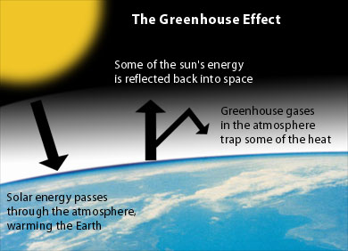

Arrhenius (Swedish chemist), 1896
Notes:
http://www.environmentalsociety.ca/issues/climate/images/greenhouse-effect.jpg
http://en.wikipedia.org/wiki/Svante_Arrhenius

Slide 12
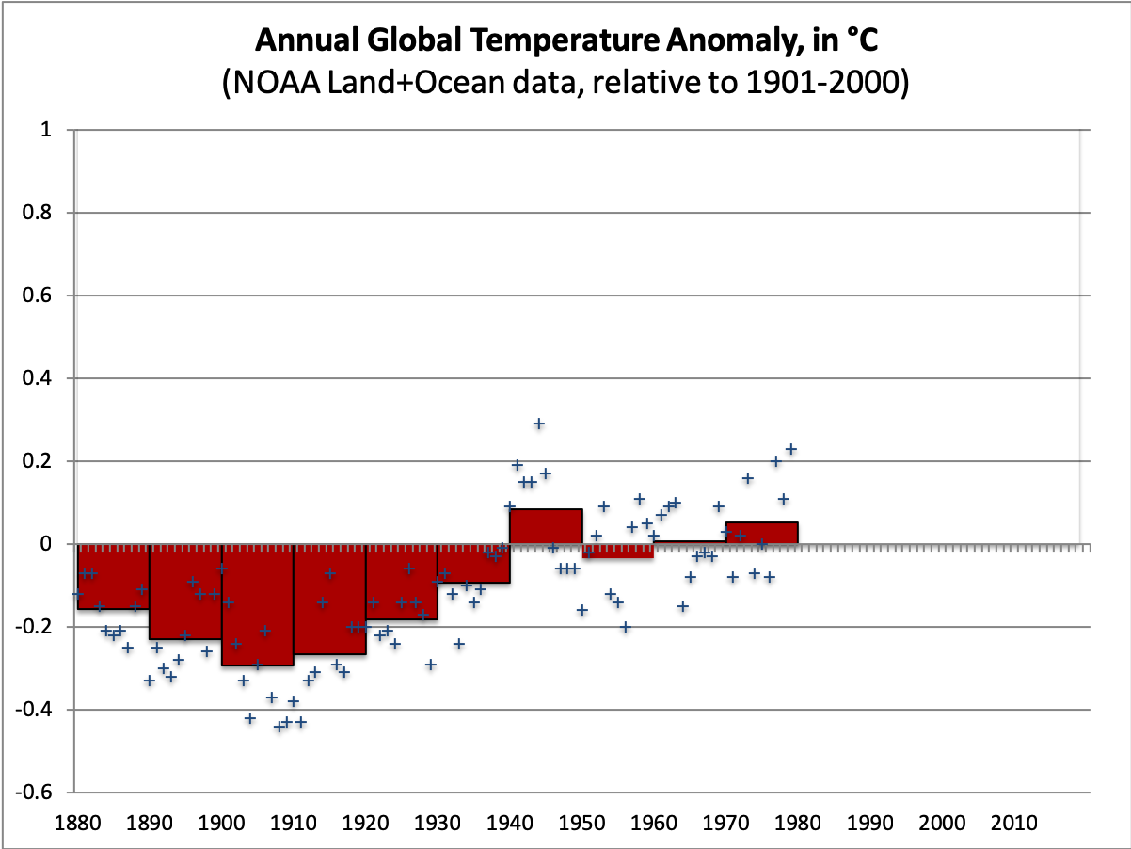
Notes:
https://www.ncdc.noaa.gov/cag/time-series/global/globe/land_ocean/ytd/12/1880-2017

Slide 13
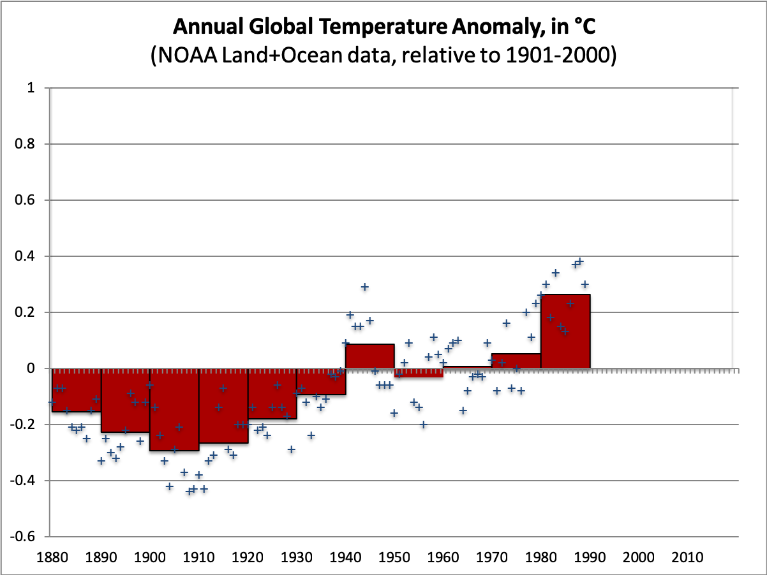
Notes:
https://www.ncdc.noaa.gov/cag/time-series/global/globe/land_ocean/ytd/12/1880-2017

Slide 14
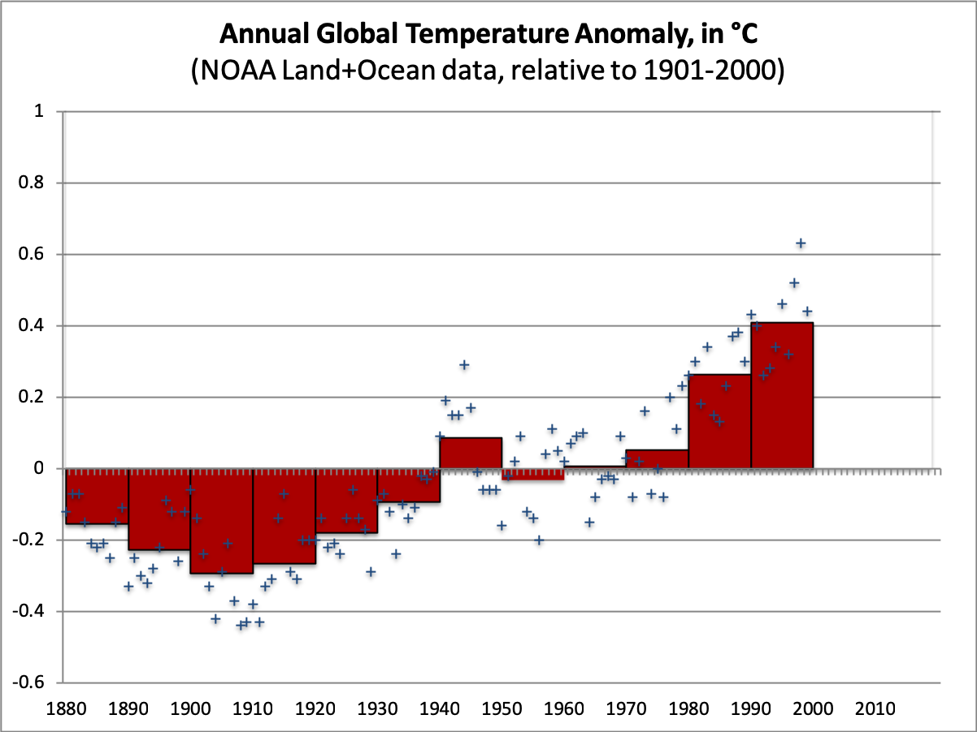
Notes:
https://www.ncdc.noaa.gov/cag/time-series/global/globe/land_ocean/ytd/12/1880-2017

Slide 15
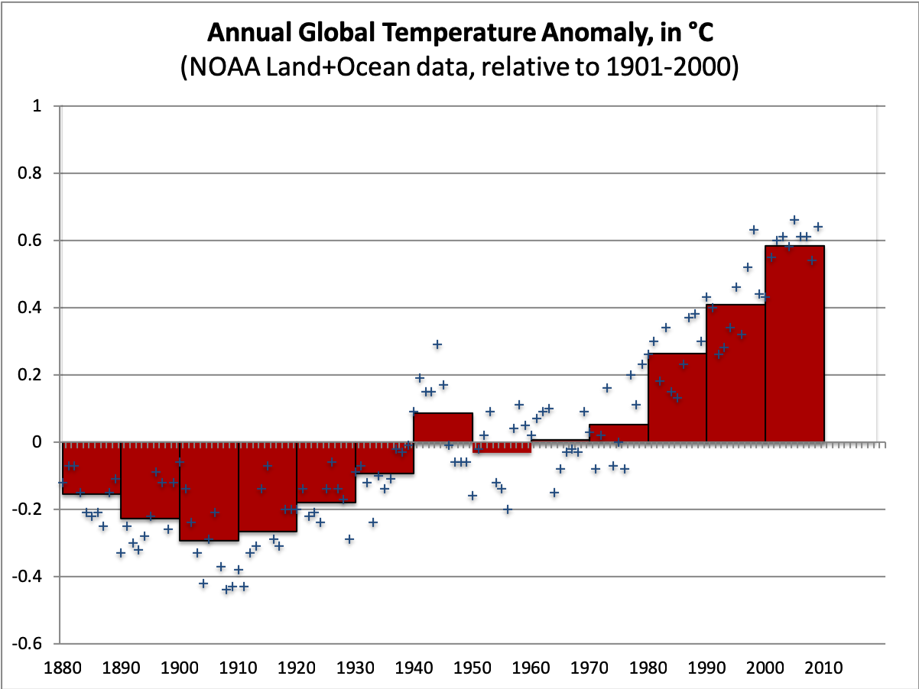
Notes:
https://www.ncdc.noaa.gov/cag/time-series/global/globe/land_ocean/ytd/12/1880-2017

Slide 16
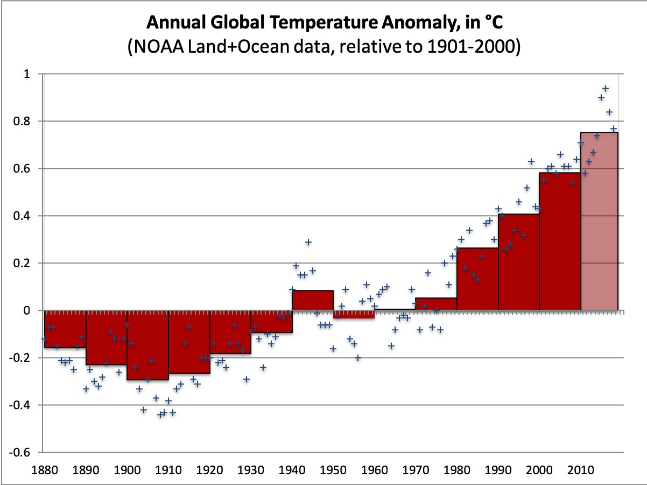
Notes:
https://www.ncdc.noaa.gov/cag/time-series/global/globe/land_ocean/ytd/12/1880-2017

Slide 17
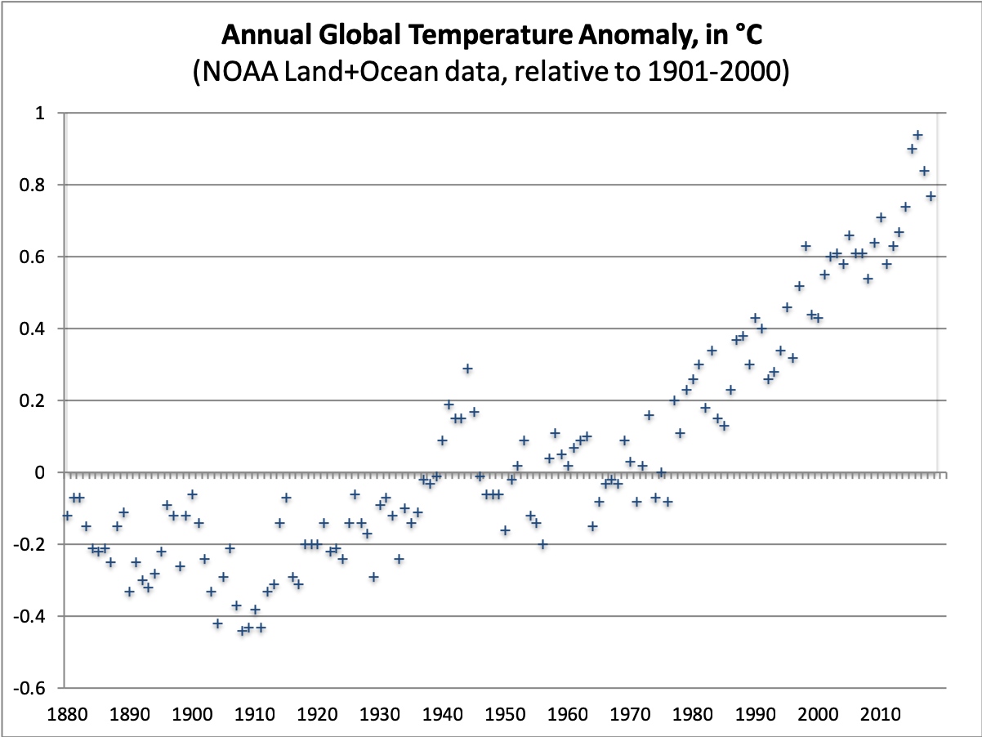
The way to get less pollution
is to make polluting expensive.
Notes:
https://www.ncdc.noaa.gov/cag/time-series/global/globe/land_ocean/ytd/12/1880-2017

Slide 18
Goal #1: Reduce greenhouse gas emissions
A carbon price is the single best step we can take.
Even a modest $10 carbon tax (equal to about 10¢ per gallon of gas, 1¢ per kWh coal-fired power) could push Utah utilities away from coal and cut Utah CO₂ emissions by 20% or more.
A $10 carbon tax would generate over $500m a year.

Slide 19
Goal #2: Improve local air quality
Air pollution affects our families and our economy.
Carbon tax revenue can put $40 million a year into programs to reduce air pollution: cleaner school buses, cleaner freight-switcher locomotives, battery-powered lawnmowers, etc.

Slide 20
Goal #3: An economy that works for all
Promote rural economic development, including but not limited to broadband access.
Rural economic development and local air quality programs get about 10% of the carbon tax revenue.
The remaining 90% goes to tax cuts that will benefit households and businesses across the state, especially low-income families.

Slide 21
Tax cuts in the bill (≈$450m per year)
≈$140m: Eliminate state sales tax on food.
≈$70m: Eliminate state sales taxes on electricity and home heating fuels.
≈$60m: 10% match of the federal EITC (up to $600 a year for 200,000 low-income working families).
≈$60m: Extend and expand Retirement Tax Credit.
≈$100m: Reduce taxes on EITE businesses.

Slide 22
Please join us!
A modest carbon tax: $10 per ton CO₂.
10% of the revenue goes to improve local air quality and boost rural economic development.
90% of the revenue goes to cut existing taxes, e.g., eliminate the state sales tax on food.
HB403 was sponsored in 2018 by D and two R’s. Our focus now is on the 2019 legislature.

Slide 23
Market-based action on climate and air pollution
Yoram Bauman and Tom Moyer, Climate Utah
www.climateutah.com

Slide 24
State Legislation
  Tom Moyer
    Robotics engineer and climate activist
    CCL’s state coordinator and leader of Climate Utah
    A driving force behind the 2018 Utah Resolution on Emissions Reduction
    Concentrating on the tax modification bill.
The resolution’s history
The process for this bill, where we are in it, what’s next
What our state representatives and their constituents can do

Slide 25
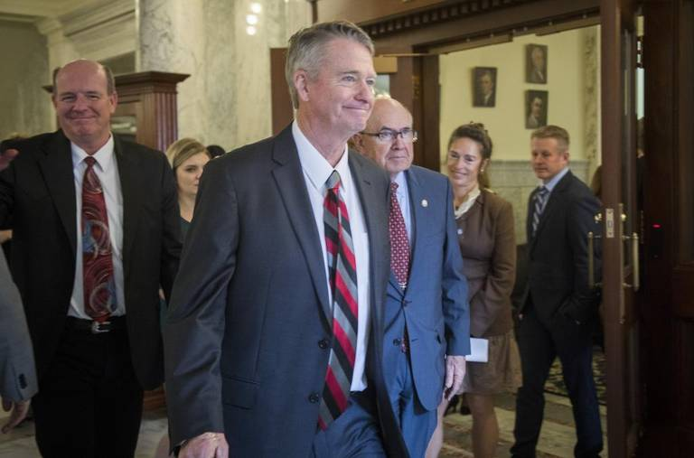
Idaho governor:
Climate change is real, and it must be reversed
Notes:
Share title and housekeeping welcome

Slide 26


Slide 27

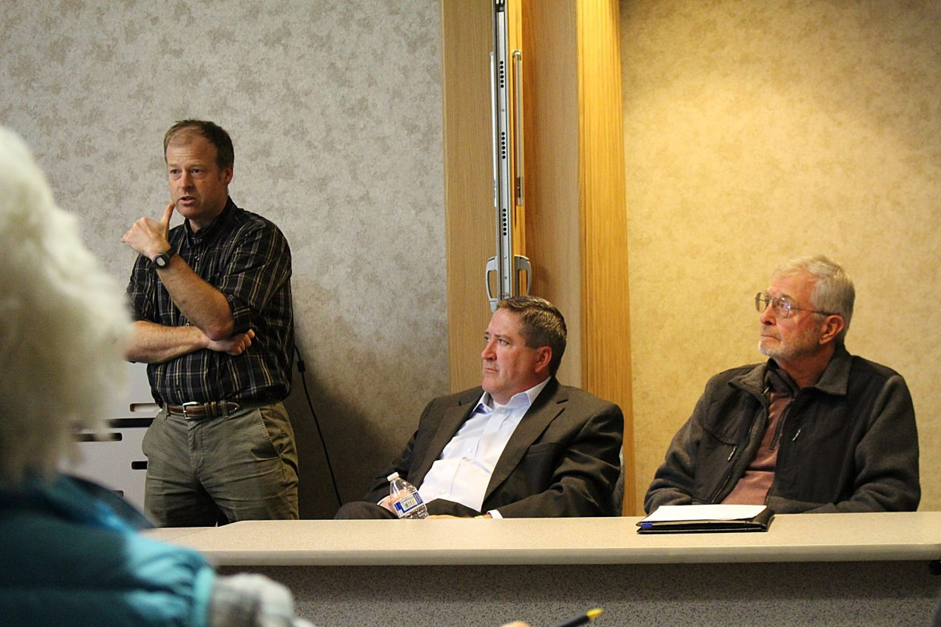
Who is Climate Utah?
Volunteer-driven
49 out of 75 House districts
28 out of 29 Senate districts
Partnering with: League of Women Voters, Utah Citizens’ Council
Notes:
Who is CCL? Let me tell you! :)
Citizens’ Climate Lobby is a non-profit, nonpartisan, grassroots advocacy organization focused on national policies to address climate change.
Our consistently respectful, nonpartisan approach to climate education is designed to create a broad, sustainable foundation for climate action across all geographic regions and political inclinations. By building upon shared values rather than partisan divides, and empowering our supporters to work in keeping with the concerns of their local communities, we work towards the adoption of fair, effective, and sustainable climate change solutions.
In order to generate the political will necessary for passage of our climate solution we train and support volunteers to build relationships with elected officials, the media and their local community.
At Citizens’ Climate Lobby, we’re committed to building the political will for the climate solutions we all need. As empowered citizens, we talk with neighbors, friends, and local officials about how national climate action can help ensure a healthy future while strengthening the American economy.
Our volunteers include high school students and concerned grandparents, engineers in the Texas natural gas industry and house painters from New England, and farmers from Virginia to California’s Central Valley. Some are PhD’s who have spent careers researching the intricacies of climate change; others are concerned citizens who just want to know how to help. Whatever our backgrounds, we’re all united by a commitment to making our voices heard as we call for a healthy climate future.
CCL volunteers are organized into hundreds of local chapters across the US and around the world. These chapters build political support for climate action with a variety of tools, which they use in keeping with their local culture and politics. By focusing on shared values rather than partisan divides, we build relationships with community leaders and with federal elected officials and with Congress, always starting from a place of respect, gratitude, and appreciation.
This approach often reveals a surprising openness to climate action on the part of officials who have yet to publicly embrace climate solutions. Through developing respectful relationships, cultivating and demonstrating local support, and promoting a climate solution that has appeal across the political spectrum, we move our leaders towards action that will preserve a healthy climate and a livable world.
Share more about CCL:
100k+ volunteers
Organized into 4XX local chapters
empowered to work with their representatives + in their communities towards a solution to climate change
How do we build political will?
Engaging in our communities
Some of our volunteer accomplishments from the last year:
Lobbying
1,668 Lobby Meetings
74,592 Letters to Congress
Outreach
3,392 Events
e.g. presentations, tabling
Media
4,237 Published Media
e.g. letters to the editor, opeds, interviews
Endorsements
>2,300 to date
from community leaders across the country
We’re non-partisan. We build relationships with everyone, even those who would oppose us.
We’re nonprofit, meaning that we are very volunteer-driven. Our main goal is to empower and activate folks.
We’re solution-focused. We pride ourselves on being for something, not against things. When we meet with Congress, we come with a solution. This can be tricky, as much of our society today runs on fossil fuels. So, if we oppose fossil fuels, then we are seen as opposing modern society. Instead, if we are for reducing emissions to get to a low carbon economy, then we find ourselves working with everyone.
We’re international, with the majority of our chapters in the U.S. and Canada.
And we have only one rule: to treat everyone with respect, appreciation and gratitude, even those who oppose us. Citizens’ Climate Lobby is for people who understand that this is our problem and accept the responsibility of solving it.

Slide 28
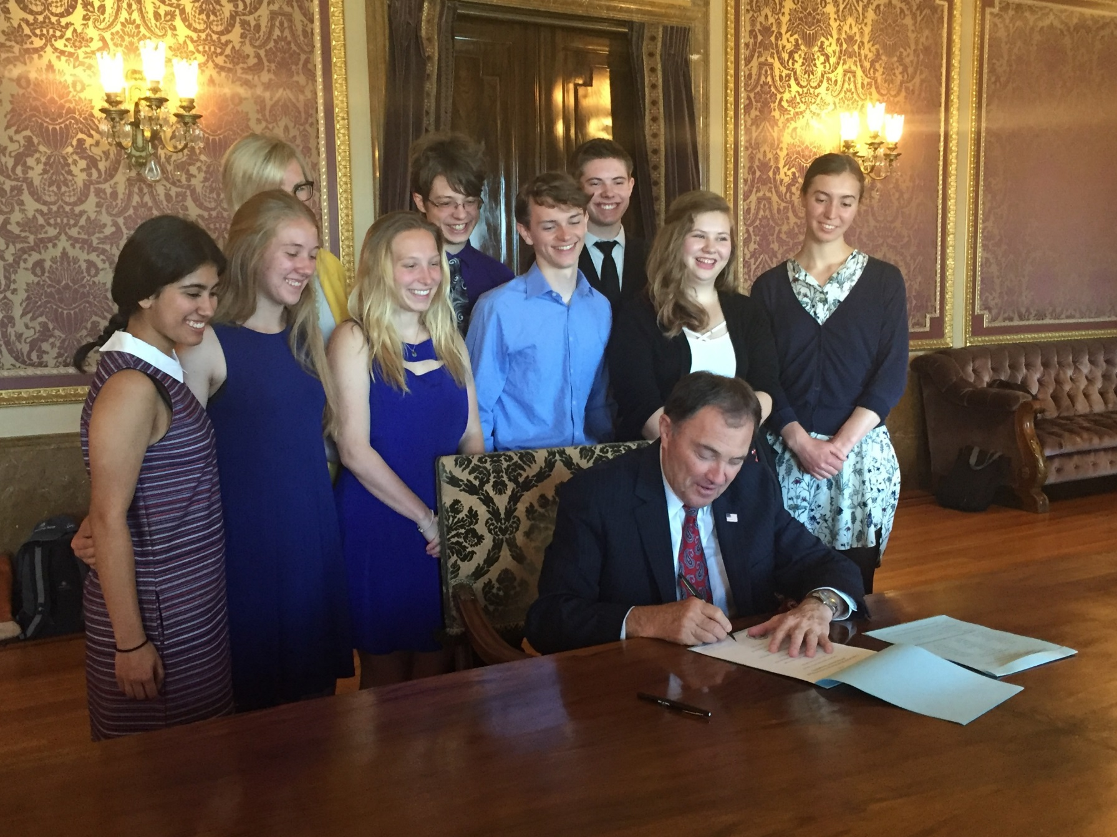
Utah Passes Environmental Stewardship Resolution
Notes:
The resolution’s history

Slide 29
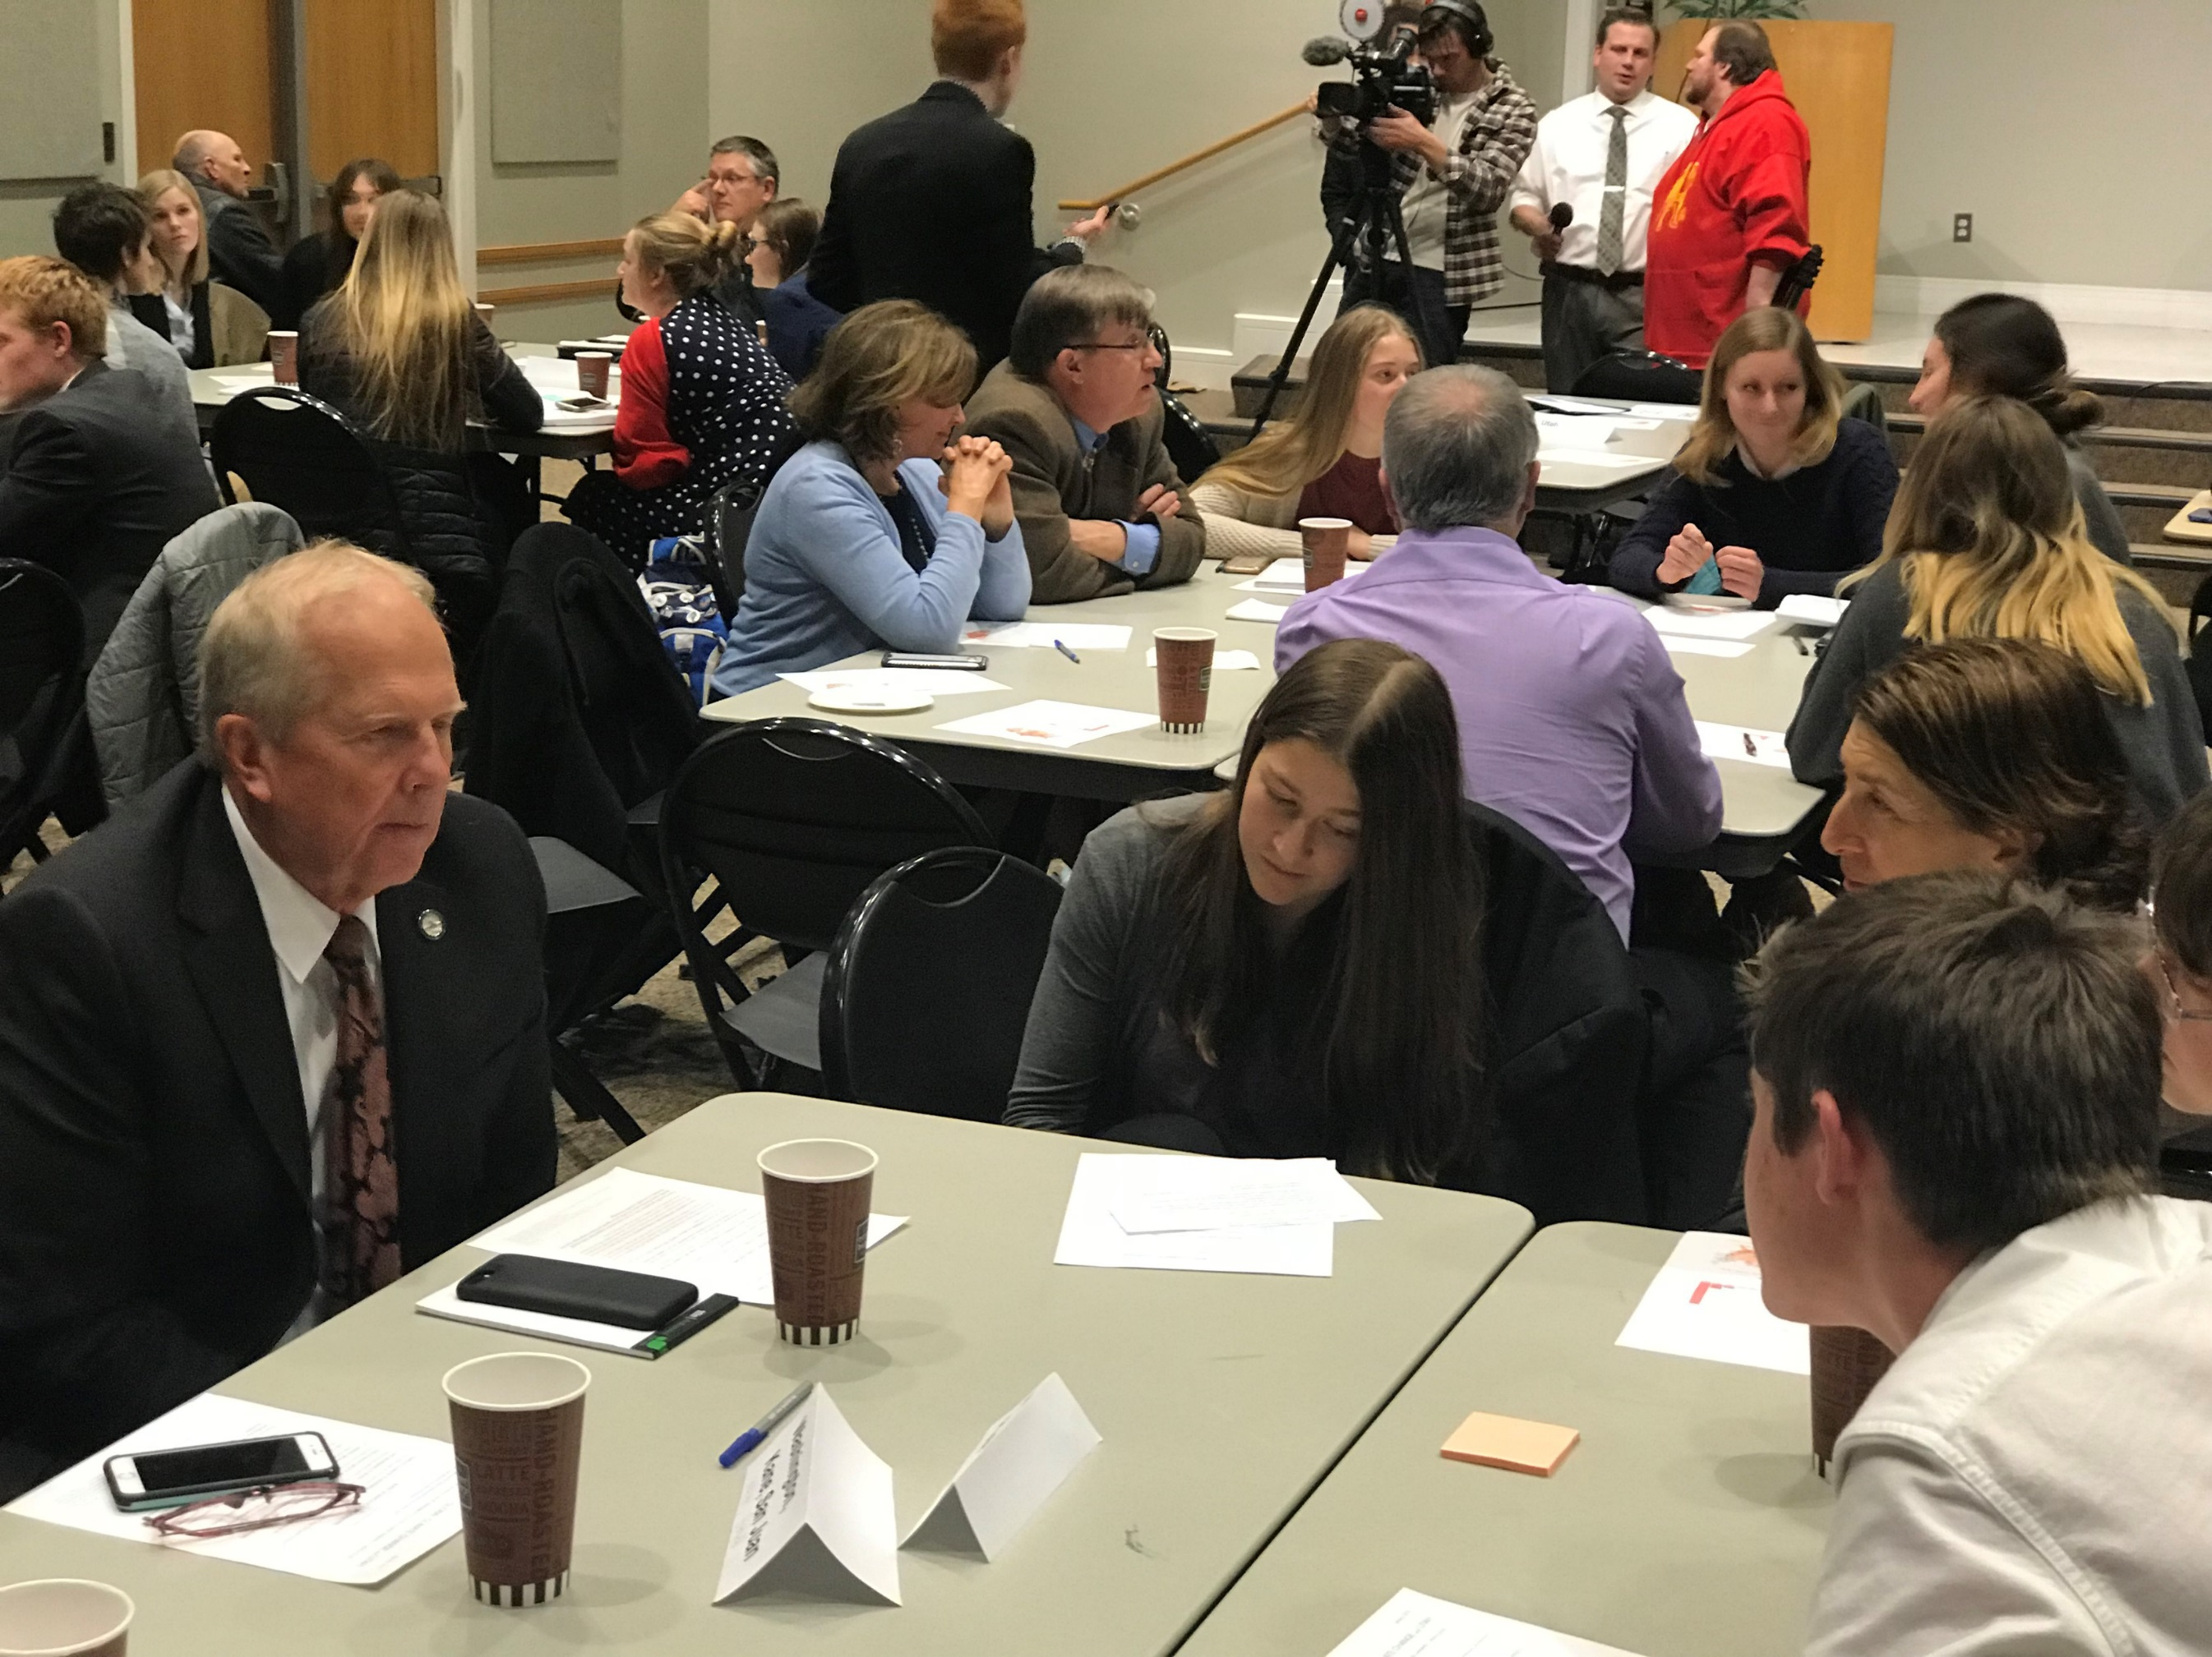
Building Relationships with Legislators

Slide 30

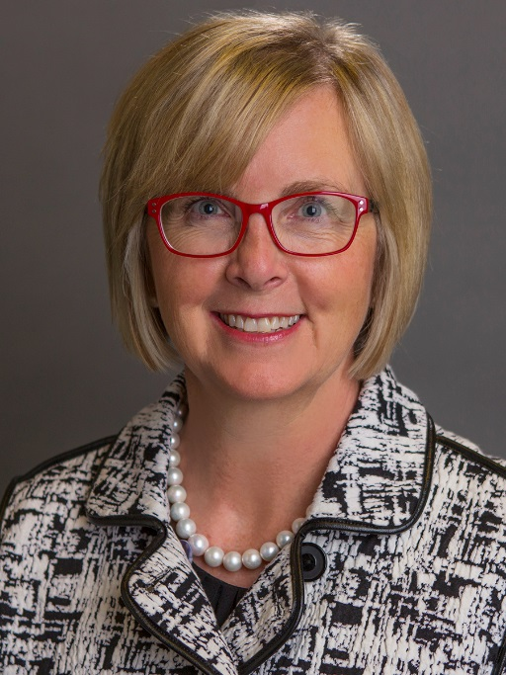

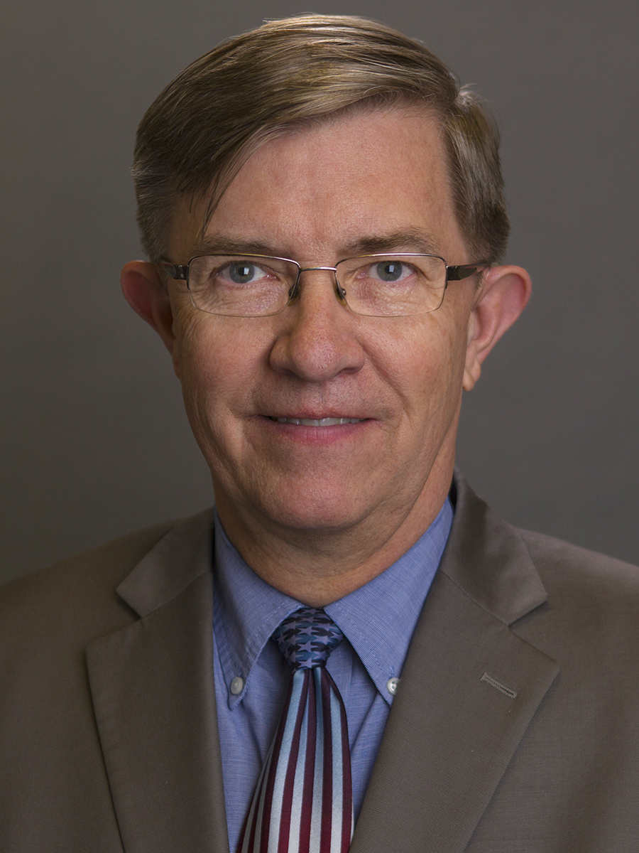

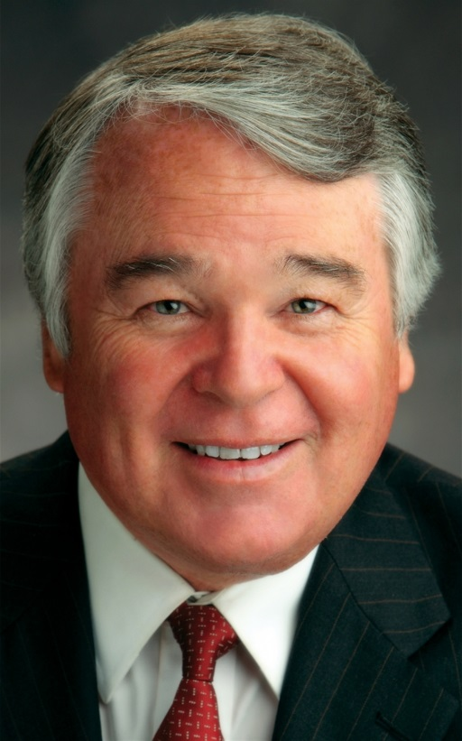

Utah HB403
Carbon Pricing
Fossil fuels are taxed at a rate of $10 per metric ton of carbon dioxide emissions.
Tax Cuts
Tax cuts return about 90% of the revenue directly to Utah households and businesses.
For most low-income families, the tax cuts will more than make up for increased energy costs.
Rep. Becky Edwards
(R – North Salt Lake)
Targeted Spending for Air Quality
The remaining revenue (about 10%) is spent on programs to reduce local air pollution and to boost economic development in Utah’s rural communities.
Rep. Joel Briscoe
(D – Salt Lake City)
Rep. Dixon Pitcher
(R – Ogden)
Notes:
The process, where we are in it, what’s next
What we’d like our state representatives and their constituents to do

Slide 31



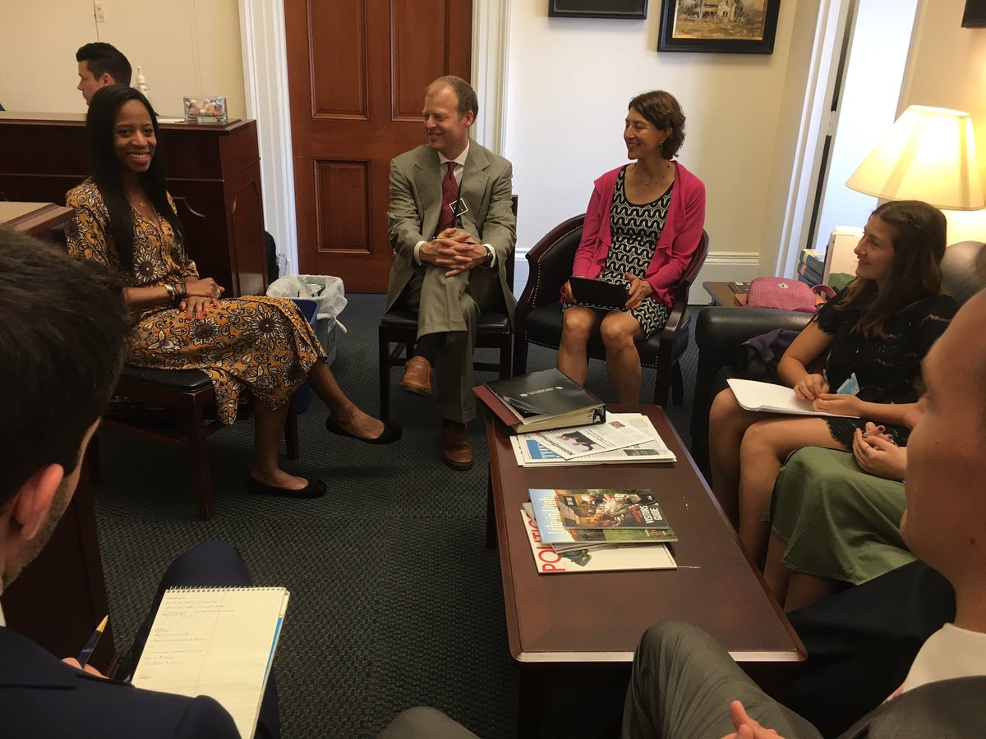



Our Values
Focus
Relationships
Nonpartisan
Personal Power
Integrity
Optimism
Notes:
What We Believe In
Citizens’ Climate Lobby is a non-profit, nonpartisan, grassroots advocacy organization focused on national policies to address climate change. These core values guide our staff and volunteers along the way: https://citizensclimatelobby.org/about-ccl/values/
Focus
We are focused on what we see as the single most impactful solution to climate change — a national carbon fee and dividend. We know it will not solve the problem entirely, and appreciate the work that our friends in other groups are doing. So that we can be effective, we do not let ourselves get distracted by work that does not support our core purpose. After we accomplish our goal, we will tackle the next most impactful solution.
Relationships
We take the most generous approach to other people as possible — appreciation, gratitude, and respect. We listen, we work to find common values, and we endeavor to understand our own biases. We are honest and firm. We know that there is a place for protest, but our approach is to build consensus — that’s what will bring enduring change. That’s why elected officials and their staff, no matter what their politics, say they are happy to see us — and mean it.
Being Nonpartisan
Our group is open to all who are serious about solving climate change. You are welcome no matter where you live, what you wear, what you do for a living, or who you voted for in the last election. We work with elected officials and community leaders from across the political spectrum because we believe that everyone is a potential ally.
Integrity
We are prepared and do our research. We are always on time for meetings. Our approach is thoughtful & thorough. We consult experts and use data. We are open to new information; in fact we solicit opposing opinions. We refine our solutions to make them better. We follow up when we are asked. We keep on.
Personal Power
We use our voices to be heard. This simple act transforms us from spectators to engaged citizens, and it reveals the true nature of democracy to us. We are volunteer-driven — trusting volunteers to make important decisions, and to create and develop things that will be valued by Citizens’ Climate Lobby.
Optimism
We believe that people are good, and that democracy works. We are confident that our approach will work because we see progress. We stand for a solution, not in protest of other solutions. We don’t expect perfection from ourselves or others; this is a process and we know that people can improve. Together, we are a community that offers one another comfort, support, and fun as we work.

Slide 32
“CCL comes in and they say this is a problem we have and we’re wondering if you can help us solve this problem – instead of you’re the problem.”
“It not only changed my mind about my involvement, but really changed my heart about what we should be doing.”
Rep. Mia Love (UT - 04)
Notes:
https://teddeutch.house.gov/news/documentsingle.aspx?DocumentID=399440

Slide 33
Federal Legislation
  Bill Baron
    Former small business owner, Alta ski patroller and marshal, advocate for climate action
    Campaigned as a non-partisan, single issue “climate candidate” in past elections
    With CCL since 2010, attracted by its nonpartisan, positive approach, and citizen engagement.
    Founded Utah’s first CCL Chapter and is now its Mountain West regional coordinator.
What the bill would do
The process for the bill, where we are in it, what’s next
What our Congressional delegation and their constituents to do

Slide 34
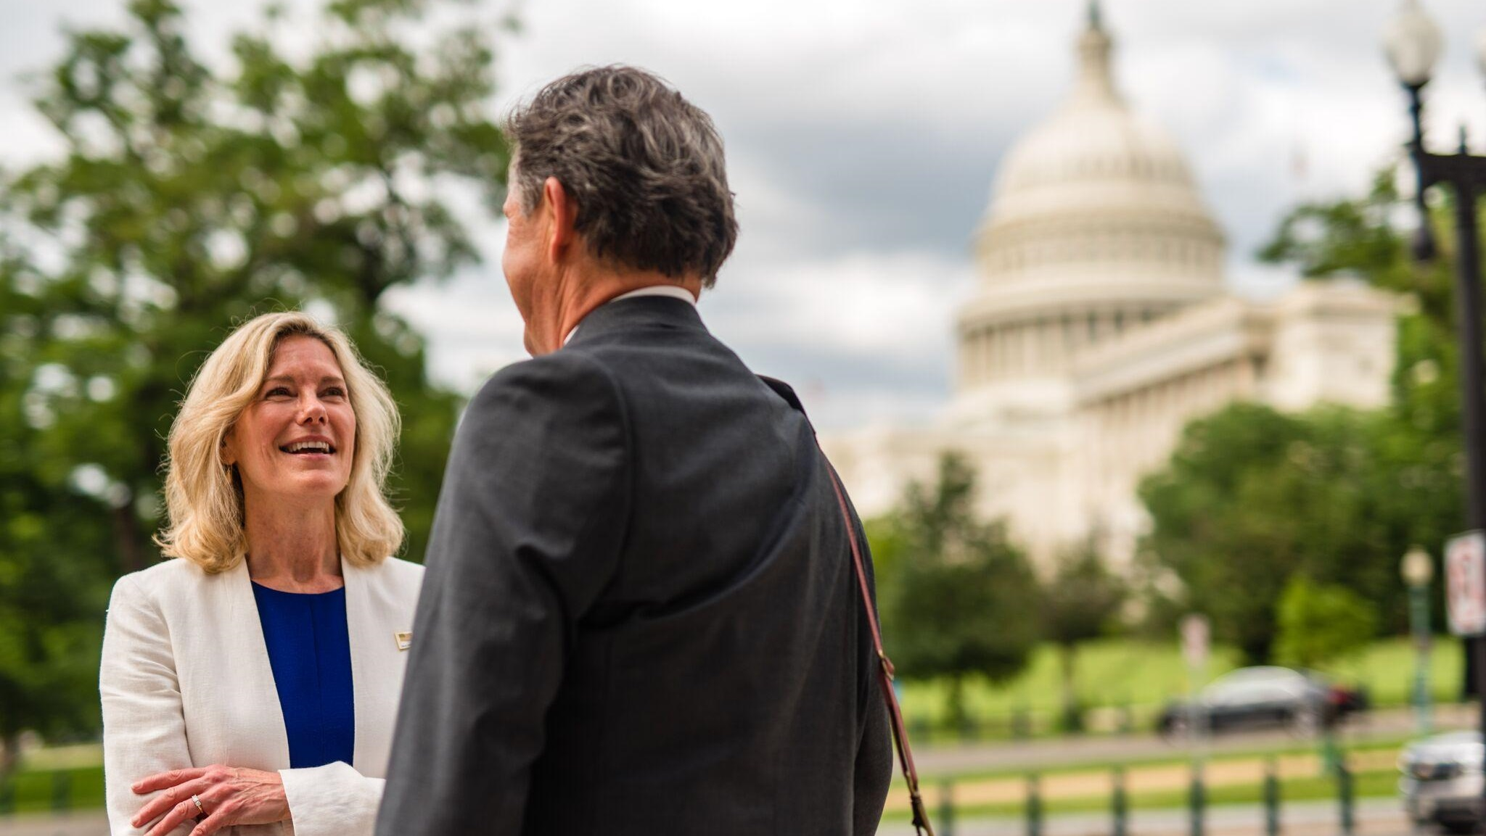

What’s our Solution?
The Energy Innovation and Carbon Dividend Act
S. 3791 / H.R. 7173
Notes:
Introduced in the lame duck session
Bipartisan and bicameral, will be reintroduced in this Congress
November 27, 2018 introduced in the US House of Representatives. 3R/7D’s (D’s of key committees) Ways and Means, Energy and Commerce and Foreign Affairs
December 19, 2018 companion bill introduced in the Senate 1R/1D (key committees Finance, Energy and Natural Resources, Environment and public works)
-Market based solution: want less of something, make it more expensive Simple, Predictable, transparent, economy wide, difficult to game
•predictability for businesses
•works in parallel with existing carbon pricing systems
protects low and middle income households 2/3 do better or break even
●The goals, the targets, the forcing mechanisms in this policy are more aggressive than anything we’ve seen submitted in Congress.

Slide 35




What Will It Do?
Effective
Good for People
Good for the economy
Bipartisan
Revenue Neutral
Notes:
High level messaging
From the perspective of building broad (mainstream) support for the bill CCL asks its volunteers to stay as focused as possible on this messaging.
Word choices have been carefully chosen
Keep it simple and high level.
With audiences, if you get drawn into the details please try to pivot back to the high level messaging
Effective: Reduce emissions by at least 40% within 12 years. Supported by economists and scientists as simple, comprehensive and effective
Good for People: this policy will improve health and save lives by reducing pollution that Americans breathe. Additionally, the carbon dividend puts money directly in people’s pockets every month to spend as they see fit, helping low and middle income Americans.
Since the carbon fee increases steadily, the dividend also increases.
A family of four would receive $288 per month, or $3,456 per year, after 10 years, and $396 per month after 20 years.
Products made with clean energy become relatively less expensive, and consumers have more money to spend.
Good for the economy: Create 2.1 million additional jobs over the next 10 years, thanks to growth in the clean energy economy.
Bipartisan: R’s and D’s are both on board, cosponsoring this bill together. The majority of Americans support Congress taking action on climate change, including more than ½ of R millennial voters. Solving climate change is too urgent to get caught up in partisan politics
Revenue neutral: fees collected on carbon emissions will be allocated to all Americans to spend any way they choose. The government will not keep any of the fees collected, so the size of the government will not grow.

Slide 36
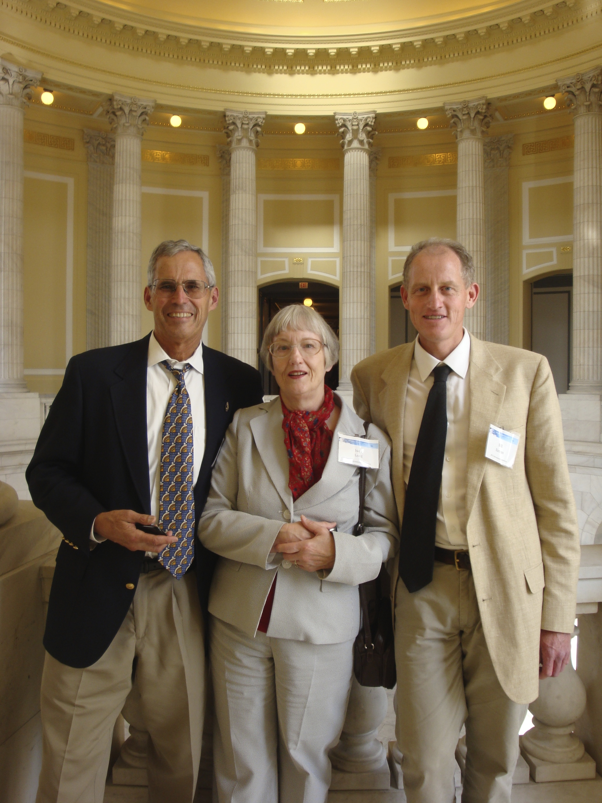




Carbon Fee
Carbon Dividend
Carbon Border
Adjustment
Limited
Regulatory Adj.
Notes:
Carbon Fee-fee on the greenhouse gas emissions from fossil fuels (like coal, oil, and gas).
Fee is placed as far upstream as possible
• Fee on CO2-e starts at $15 per metric ton
•Increases by at least $10 per ton per year. If interim emission levels are not met, fee will increase to $15/ton
•Fluorinated gases also covered, 10% of GWP (Spain-a 2% tax of GWP led to a 45% reduction in HFC’s)
**fee does not cover fugitive methane, nitrous oxides, black carbon and other greenhouse gases that aren’t from fossil fuel combustion
•Exemption for agricultural use chiefly diesel fuels, an extension of what is already in place (account for less than 1% of our total emissions)
“non-fossil fuel emissions that occur on a farm” are not subject to the carbon fee
•Rebate for safe and permanent Carbon Capture & Sequestration by coal, oil, natural gas. Leakage or seismic disruption would need to be addressed by law
Dividend: The dividend acts like a stimulus. People spend it, so it goes back into the economy and creates jobs: 2.1M jobs created over ten years and that’s greater than a 1% increase in employment that we get without carbon fee and dividend.
•Regressive unless the fee is returned to households
•Equal shares to all adults with valid SSN or TIN.
•All dependent children under 19 years old in an eligible household will be entitled to receive a half-share Carbon Dividend
•Dividend will be distributed monthly
•1 month “prebate” to ensure the public receives funds to absorb initial cost increases before prices actually rise
•Taxable but will not be counted as income or taken into account for any Federal benefit or assistance programs (eg Medicaid, SNAP, etc)
•Administered by Treasury
•Administrative costs not to exceed 2%
•Average GDP growth over 20 years is $70 – $85B dollars. That’s a 1.375 trillion-dollar boost in economic output than we would have without Carbon Fee and Dividend.
Border Carbon Adjustment: a provision built in to protect trade competitiveness: a “Carbon Border Adjustment” imposed on carbon-intensive goods that cross our border in either direction. Products imported from a country that does not bear a carbon price equivalent to ours will have to pay a surcharge to make up the difference. Conversely, an American-made product exported to such a country will get a refund for the carbon fee associated with its carbon footprint.
•protect U.S. manufacturers and jobs
•discourage businesses from relocating to where they can emit more CO₂
•encourage other nations to adopt an equivalent price on carbon.
•rewards producers, consumers, and other nations if they emit fewer greenhouse gasses
•exported fossil fuels are eligible for the border adjustment. US exporter would get a refund equal to the difference between the US carbon fee and the destination country’s carbon price. No exporter would ever get a refund of more than the embedded carbon fee. This would keep the price of exported US fossil fuels on par with their foreign competitors regardless of the carbon price. This means that it would only affect which country’s fossil fuel is used, not the total amount used
•Designed for WTO compliance (The best case: we don’t have to use it)
Limited Regulatory Rollback: Senate and House versions of the bill handle regulations differently
•Senate version calls for a review of regulations related to greenhouse gas emissions covered by the carbon fee after 6 years
•House version includes narrow limits on regulations related to greenhouse gas emissions covered by a carbon fee, so that those emissions are not subject to both the fee and regulation for the first 10 years. After that time, if emission targets for the bill are not being met, regulatory authority over covered emissions would be restored. The policy provides for continued authority for the EPA to keep our air and water clean and healthy, and allows for the continuation of vehicle mileage standards. Even more, it explicitly preserves the rights of states and municipalities to regulate greenhouse gas emissions, or to enact whatever climate initiatives they like. Congress can also always enact further legislation addressing climate change as it sees fit, or as the public demands.
Things that are explicitly protected:
i.EPA rules that don’t directly regulate covered greenhouse gases will remain untouched and still in effect: pollutants like NOx, sulfur, ozone, particulates, and mercury;
ii.CAFE mileage standards for cars and trucks;
iii.GHG authority over non-road vehicles and aircraft;
iv.the methane abatement program that applies to leaked and vented methane from oil and gas operations.
v.You could still regulate GHGs for their impacts on health. E.g. in Frontline communities where there are lots of methane leaks, you can regulate it for the health impacts, just not the climate impacts of that GHG.
vi.Since the Clean Power Plan itself said that carbon prices we’ll achieve by year 3 of this policy are better than the emissions it would achieve, we feel very good about making this trade.
vii. Importantly, if cumulatively emissions targets aren’t hit after 10 years regulatory authority restored.

Slide 37
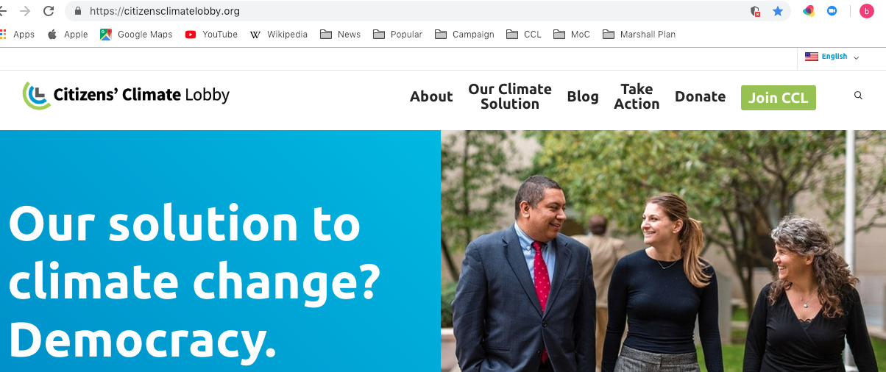
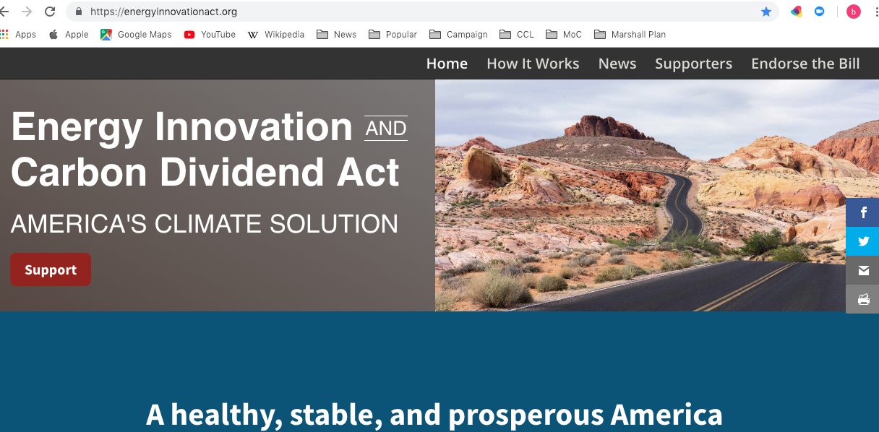
citizensclimatelobby.org
energyinnovationact.org
Notes:
How to find resources, see supporters/news/statements

Slide 38
Local Resolutions
  Sarah Thomas
    Public Lands Program Manager for Conserve Southwest Utah
    Member of CCL in St George
    A citizen interested in taking action for clean energy.
What’s in the resolution
The process for them
What our local representatives and their constituents can to do

Slide 39
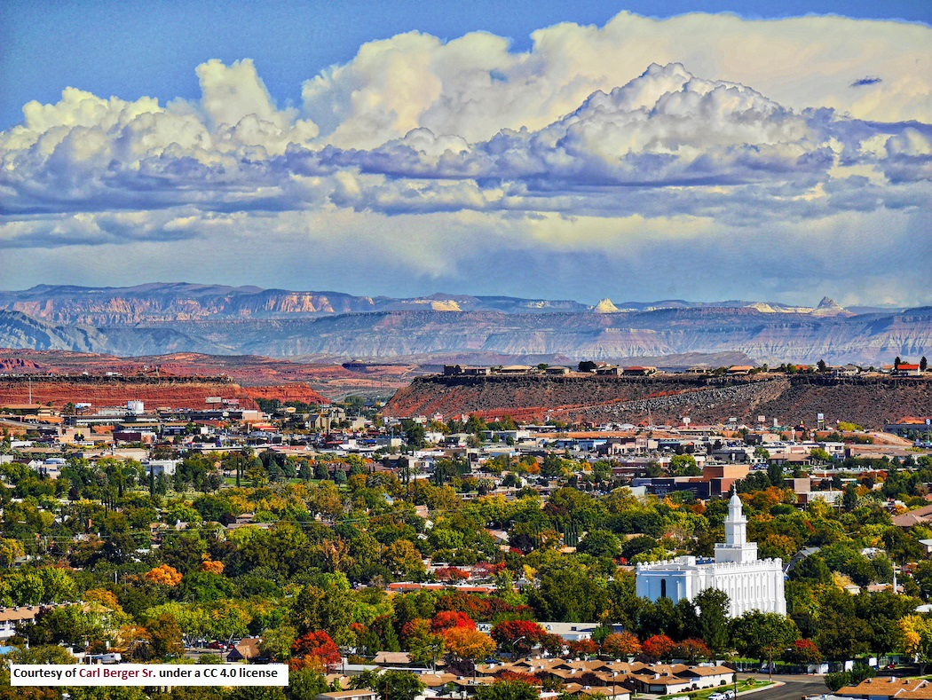
Local Resolutions will Encourage
the move to clean energy
choices for energy sources
local solutions
lower costs
excellent quality of life
Courtesy of Carl Berger Sr. CC 4.0 license
Notes:
We are working on a local resolution that will:
1- encourage the move to clean energy, including wind and the development of solar, in the right places. (We have around 310 days of sunshine per year in St. George)
2- create energy independence for Washington County. We can generate our own power locally, and give our residents the choice to generate their own power. (We don’t have to be wedded to coal forever AND the shift from coal to renewable energy would improve our local economy. We can create renewable energy jobs here).
3- lower cost (Really- the cost of living, now, and in the future. For example, the cost of heating and cooling our homes, schools, work places, and institutions will be less.
4- Protects the high quality of life that makes St. George and surrounding areas appealing to families, businesses, tourism, the outdoor recreation industry, and more.

Slide 40
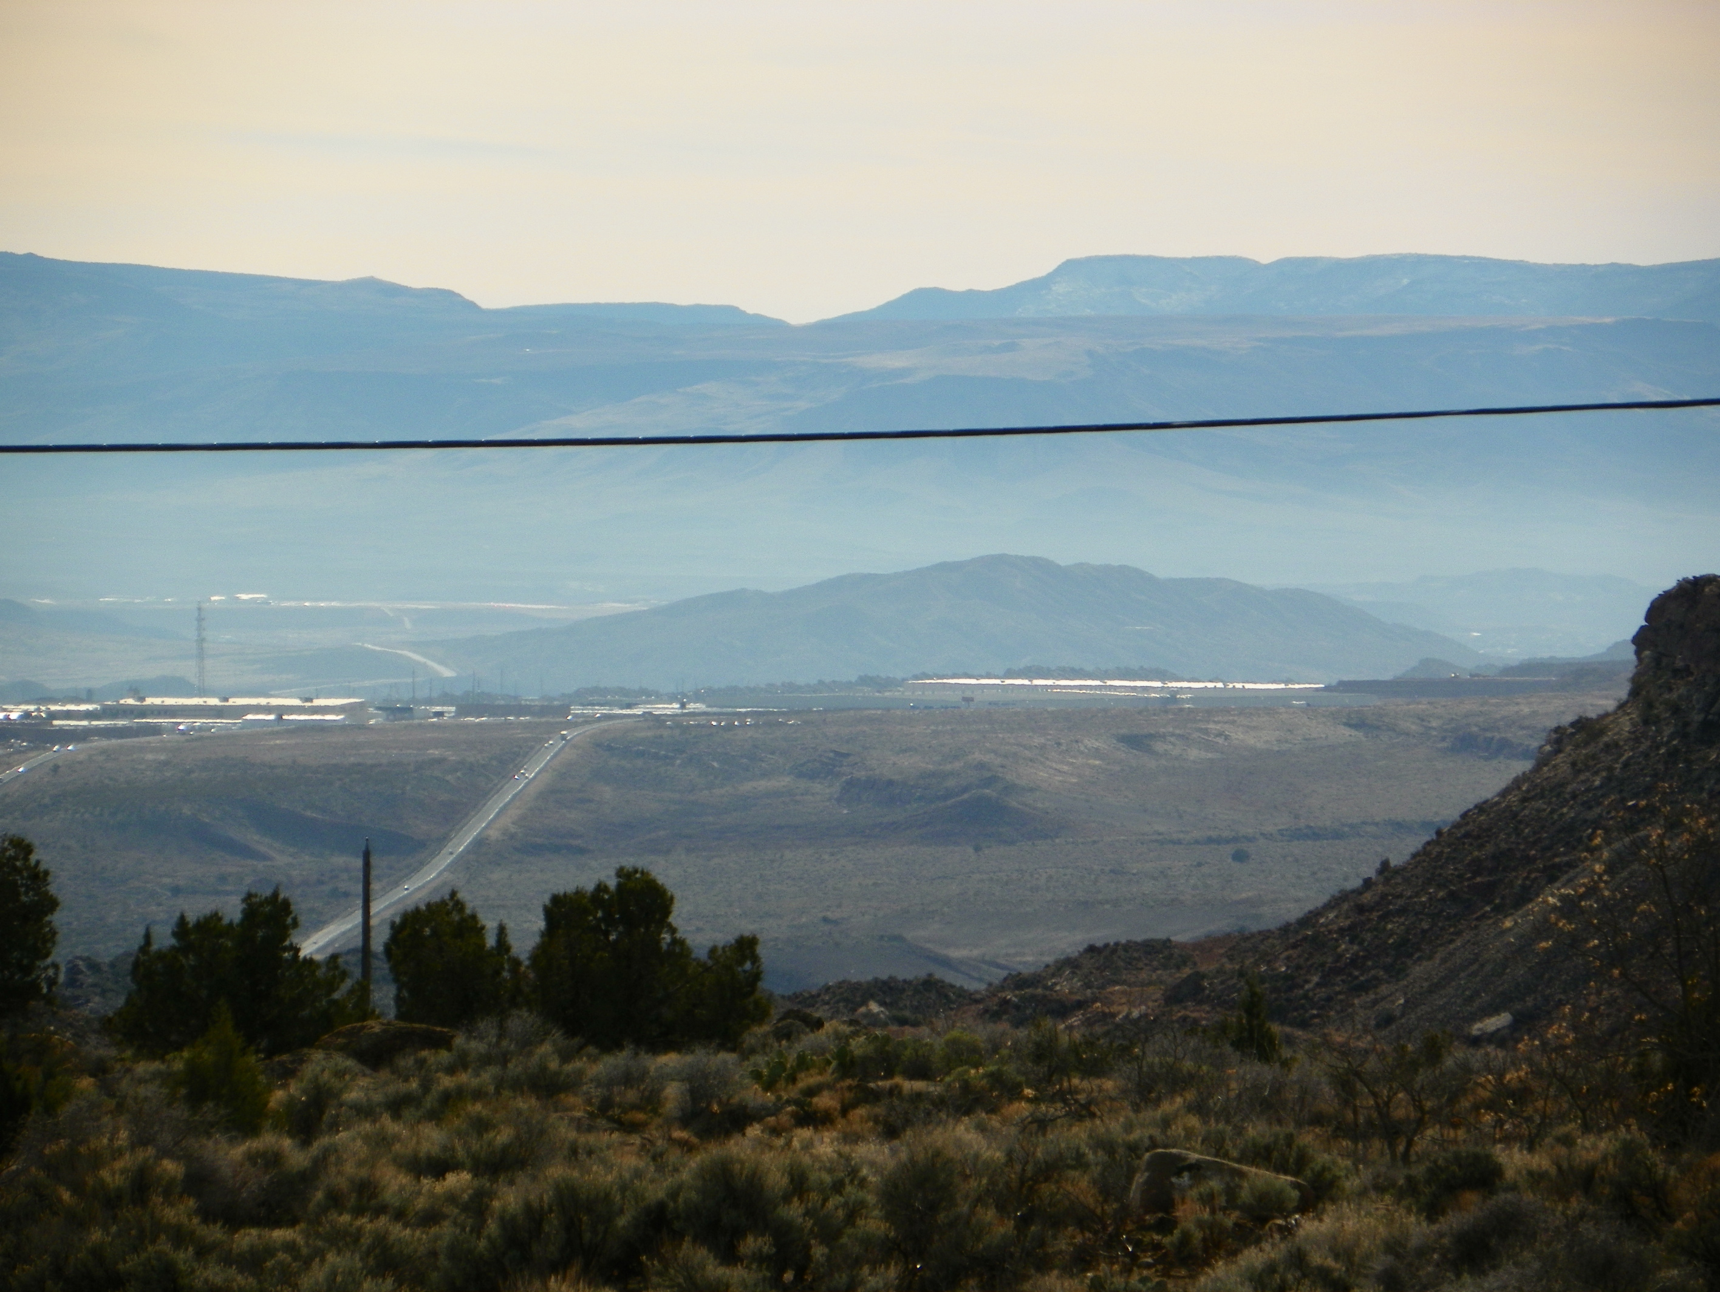
Washington County’s At-Risk Groups
American Lung Association, State of the Air 2018 Report
Using 2016 US Census Data
“C” grade for High Ozone Days
4 Orange days 2014-2016
Total Population | 160,245
Under 18 | 43,410
65 & Over | 33,420
Pediatric Asthma | 2,538
Adult Asthma | 9,749
COPD | 5,535
Lung Cancer | 42
Cardiovascular Disease | 9,062
Diabetes | 11,328
Poverty | 19,795
C. Dale Barnes
Notes:
This picture was taken this winter by Dale Barnes, a long-time Leeds resident concerned about air pollution in Washington county. He wanted to share this photo with us all today to give you a sense of what the smog in the St. George Valley looks like from a distance. In the photo, you’re looking southwest toward I-15 and the Walmart Distribution Center.
Quality of life as it relates to air quality IS something we need to worry about now. The American Lung Association’s “State of the Air 2018” Report gave Washington County a C grade for High Ozone Days. We had 4 orange days between 2014-16 (ozone levels unhealthy for sensitive groups). Ozone, commonly called “smog,” is one of the least well-controlled and most dangerous pollutants in the US. It aggravates the conditions you see on this table and disproportionately effects the young, the old, and those living in poverty.
These are the people most affected by dirty air. We can help them, and our entire community, with a Clean Energy Resolution.

Slide 41


Incentives, Education & New Grid Technology
C. Electricity Local and C. Ssuaphoto
Notes:
To meet its aims, the Washington County Clean Energy Resolution will:
1- encourage use of incentives get individuals and businesses to reduce CO2 emissions by making sustainable energy choices.
This could take the form of tax breaks on things like solar panels, energy-friendly appliances, fuel-efficient and electric vehicles, and support of energy-efficient building, excellent public transit and communities that are laid out in such a way as to allow biking or walking to work and the store. Research on these ideas, and more, will be needed to determine what will work best locally.
2- an expert team will need to form to conduct this research and share it with local elected officials as they consider adopting the resolution. Education and outreach to the community at large will also be crucial.
3- Our grid, or electric infrastructure, must be modernized in the coming years. It can be upgraded to allow easier transfer of renewable energy; utility policies can be changed to encourage local energy generation, and metering can be updated to give us advice on how to improve our usage.

Slide 42

Working Together
Team of experts
Local government
Non-gov’t orgs
Utilities
Land management agencies
Business owners
Concerned citizens
Notes:
Working together, we will form a steering committee that researches how best to implement the local resolution and presents a plan of specific actions that will preserve air quality for residents of Washington County now and in the future. Many conversations, both technical and exciting, need to happen between our local stakeholders.

Slide 43
Next Steps
1- Introduce resolution to mayors and city managers to ask for
feedback.
2- Incorporate suggestions.
3- Present resolution at city council meetings for a vote.
Notes:
Our local elected officials, city managers, city council members, business owners, community leaders, professionals and neighbors need to know that there is a local Resolution in the works to preserve clean air for ourselves, our children and grandchildren. We need to support our local elected officials during 2019 in adopting this resolution and check in with them to see how progress is coming along. Please reach out to the County Commission and your city councils to see how you can help. Thank you.

Slide 44
On your way out, look for these sheets at the Welcome Table
A Resolution for the City and County Governments of Washington County on Clean Energy
How can I support you in adopting this resolution?
Washington County Commission
197 East Tabernacle St., St. George
435-634-5700
dean.cox@washco.utah.gov
victor.iverson@washco.utah.gov
gil.almquist@washco.utah.gov
1- Take a picture of your local contacts
2- Grab a copy of the draft resolution
3- Make a phone call or set up a time to visit
Notes:
We have compiled local government contacts for you. Take a picture on your cell, grab a copy of the draft resolution, and start thinking about how you can help your local elected officials make this happen!

Slide 45
Discussion,
Questions and Answers
Follow-up:
Sign in for status reports
or send email to board@conserveswu.org
Notes:
We have a few minutes now.
Sign up to stay in touch
If you have any questions or comments, send them to board@conserveswu.org

